Slide 1
C10M: Defending the Internet at scale
by Robert David Graham
(Shmoocon 2013)

Slide 2
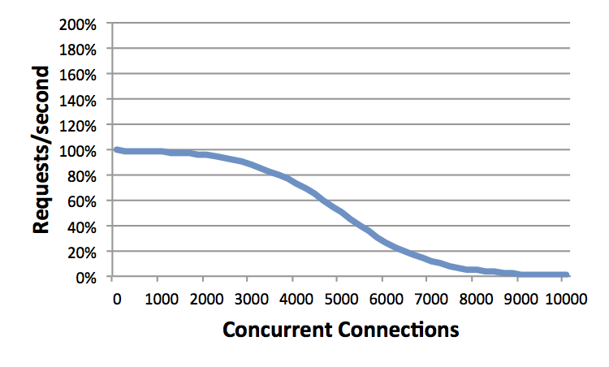
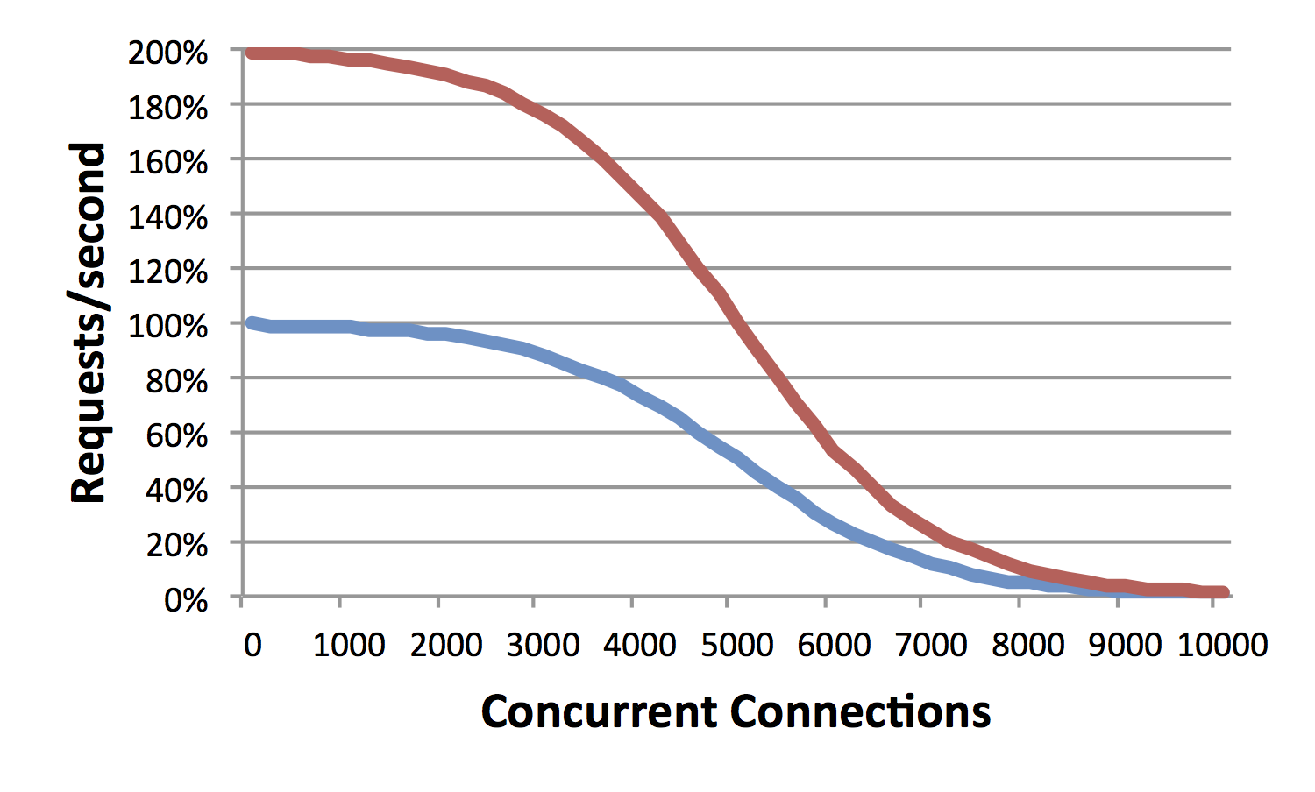
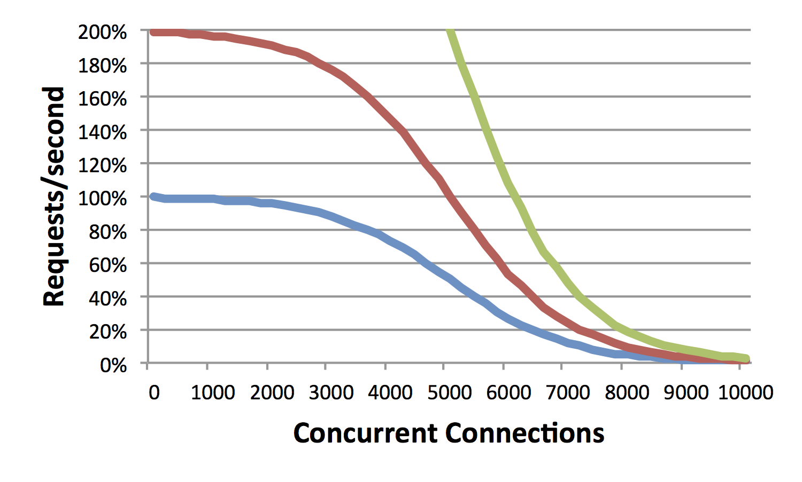
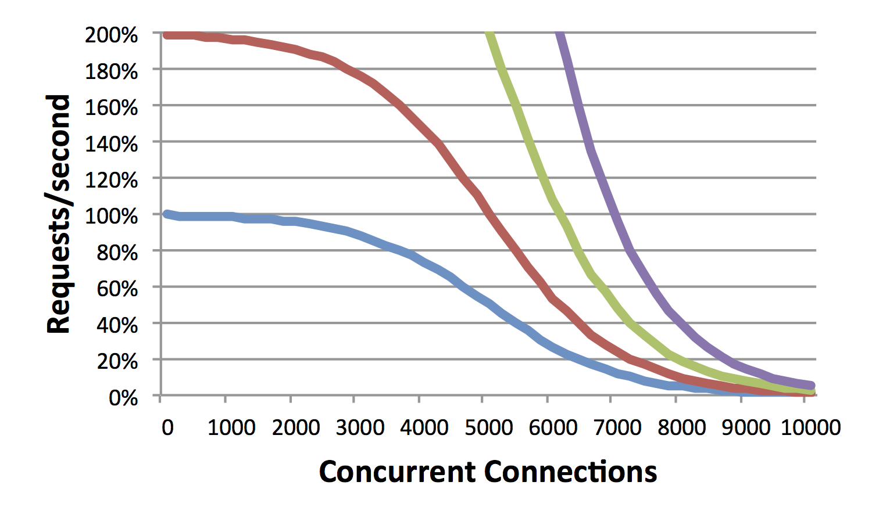
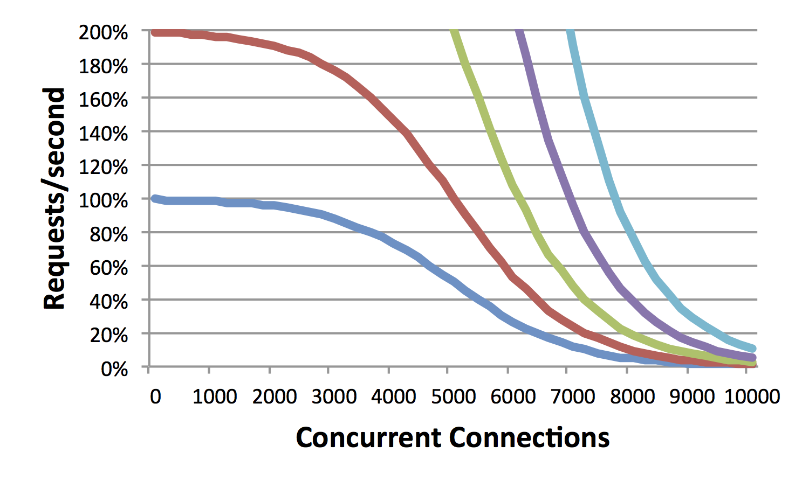
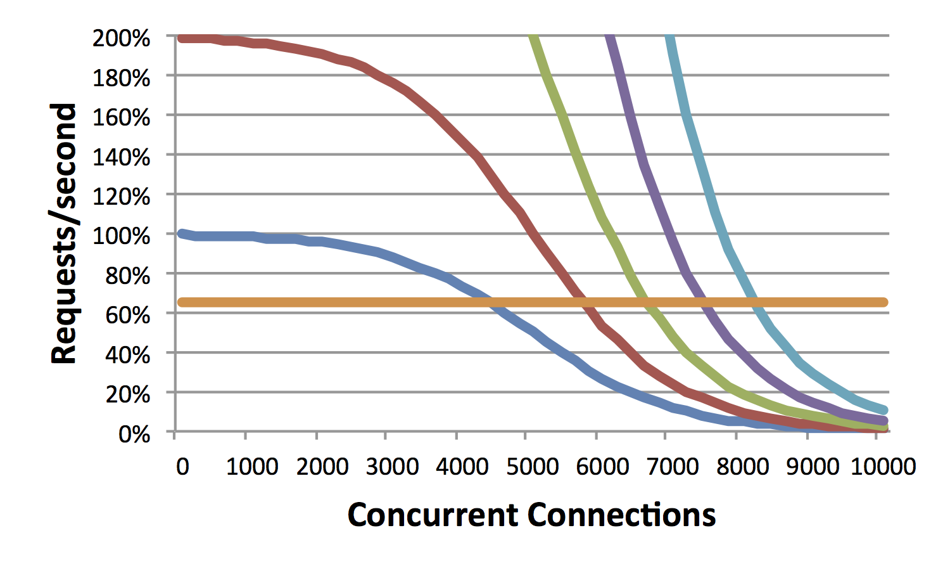
Performance
Scalability
Notes:
[THIS PAGE IS HEAVY ON ANIMATIONS. WATCH THE ANIMATIONS FIRST BEFROE READING THE TEXT]
This talk is about “scalability”, specifically, “Internet scale”. What is “scalability”?
This graph shows a well-known problem with Apache. Normally, we measure performance in “requests per second”. But there is another axis to performance: simultaneous (or “concurrent”) connections. Consider a server that handles 1000 requests per second, and that the server closes the connection immediately after serving the response. If it takes 2 seconds to handle a request, that means there will be 2,000 connections open at any point in time. Likewise, if it takes 10 seconds to handle a connection, then at 1-thousand requests per second, there will be 10,000 concurrent connections on average at any point in time. The problem with Apache is that while it can handle a few thousand open connections, it has trouble with 10,000 open connections. The more concurrent connections, the slower the web server.
Let’s say the server is performing adequately up to 5000 concurrent connections, but we want to handle 10000 concurrent connections. If we upgrade the hardware and double the speed, will that work? The second graph shows this. While we’ve indeed doubled the number of “requests-per-second”, we haven’t doubled “concurrent connections”. W/hereas it handled 5000 before, now it only handles 6000.
The same thing happens when we increase the hardware to be 4x as fast, or 8x as fast, or 16x as fast. At 16 times the speed, we still haven’t reached our target of 10,000 concurrent connections.
What I’m trying to show here is how “performance” and “scalability” are orthogonal to each other. In the rest of this talk you may be confused into thinking that I’m talking about performance, trying to make a computer run faster. I’m not. What I’m talking about is scalability.
This graph reflects the performance of Apache. Let’s instead consider a different web server called “nginx”. Nginx doesn’t reach its scalability limits until around 100,000 or even 1-million concurrent connections. On our graph, this appears as essentially a flat line out to 10,000. Consider running a high-end website like YouTube. Running nginx on this laptop (which is slow) at 10,000 concurrent connections will vastly outperform a high-end 16 CPU server system running Apache. Sure, as the left-hand side of the graph shows, this laptop would be a lot slower than a single-CPU server when the number of simultaneous connections is small, but as the right hand side of the graph shows, it vastly out peforms as the problem scales.
This graph shows one scalability problem, spe, specifically, how Apache fails at handling lots of concurrent connections. Most connections are short duration. The point from when the connection is opened, the data transferred, and then closed lasts only a second. Thus, a website may handle thousands of requests per second, but at any time, have only a few connections open.
But in some cases, requests take longer to complete, and connections stay open longer. Consider a website that handles 1000 requests/second, but where it takes on average 10 seconds to complete each request. That means at any point in time around 10,000 connections will be open.

Slide 3
who this talk is for
coders
who write internet scale stuff
everyone else
who manages internet scale stuff
who needs to know how stuff works
who needs to know what’s possible
that the limitations you are familiar with are software not hardware

Slide 4
how this talk is organized
c10k – Internet scalability for the last decade
C10M – Internet scalability for the next decade
The kernel
Asynchronous
1. packet scalability
2. multi-core scalability
3. memory scalability
Questions
bonus. state machine parsers
bonus. attacks on scalability
bonus. language scalability
Notes:
Here’s how this talk is organized.
I’m going to start with a bit of history, about how Internet scalability was defined a decade ago as “c10k”.
Then, I’m going to define the problem about Internet scalability as defined today, which I call “C10M”.
Then, I’m going to talk about 7 problems/solutions to this scalability problem. The first will be familiar with people who’ve worked at the c10k level, the remaining six will be new to people working at the C10M level of scalability.

Slide 5
c10k: a historical perspective
Notes:
To start with, let’s go back 15 years and discuss what was then known as the “c10k problem”.

Slide 6
Why servers could not handle 10,000 concurrent connections: O(n²)
Connection = thread/process
Each incoming packet walked list of threads
O(n*m) where n=threads m=packets
Connections = select/poll (single thread)
Each incoming packet walked list of sockets
O(n*m) where n=sockets m=packets
Notes:
The c10k problem was created to describe why servers failed to scale to 10,000 concurrent connections.
This was a classic n-squared scalability problem: needed performance grew as a square of the traffic.
The Apache web server creates a process or thread for every incoming connection. However, every thread context switch required walking the entire list of threads. Thus, as the number of connections increased, thread context switching got slower and slower.
An alternate way of creating a webserver is with a single thread, non-blocking sockets, and the select() or poll() function to see which sockets have waiting data. This didn’t scale, either, as every select or poll function call required walking the entire list of sockets.

Slide 7
c10k solution
First solution: fix the kernel
Threads now constant time context switch, regardless of number of threads
epoll()/IOCompletionPort constant time socket lookup
Notes:
The solution to the c10k problem came in two parts.
The first part was to fix the kernel, to make thread scheduling and socket polling “constant time”, such as the linux epoll() system call.

Slide 8
Event driven asynchronous servers
libevent
Nginx, lighthttpd, NodeJS, and so on
…and IIS
Notes:
The second solution was changing the paradigm from using threads like Apache to using asynchronous techniques like nginx. I’ll discuss asynchronous more in a moment.

Slide 9
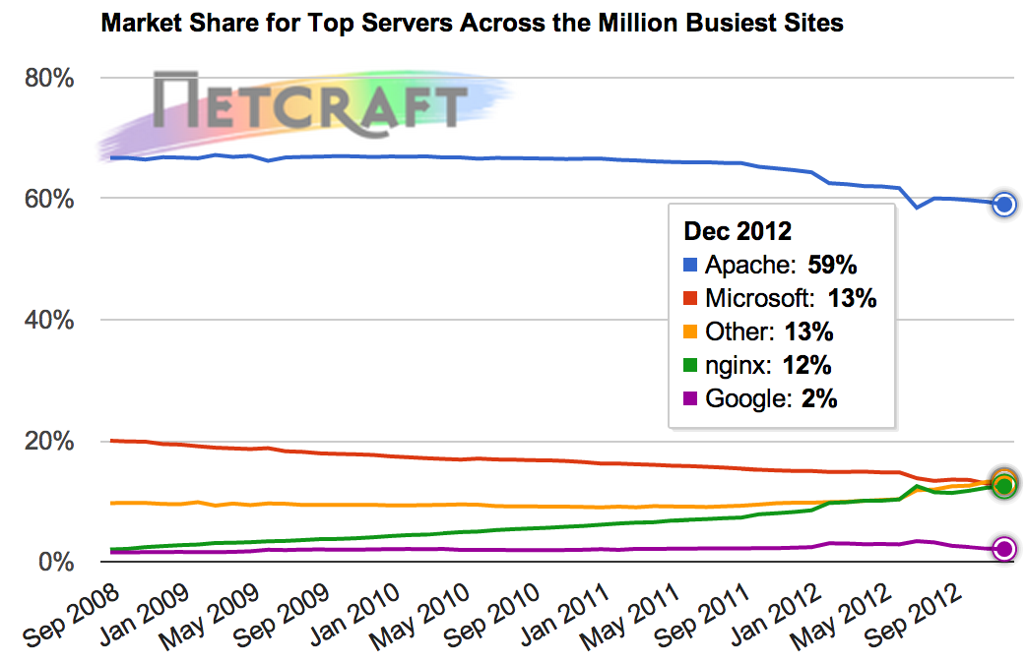
.
Notes:
Over the last several years, the web server known as nginx has become the #2 most popular web server after Apache. The reason is that Apache doesn’t scale, but nginx does. For the most part all of you should stop using Apache and use nginx instead as your primary web server.

Slide 10
C10M: the future
Notes:
But c10k and the Apache/nginx debate is for the last decade. This talk is about scalability even beyond nginx.

Slide 11
C10M defined
10 million concurrent connections
1 million connections/second
10 gigabits/second
10 million packets/second
10 microsecond latency
10 microsecond jitter
10 coherent CPU cores
Notes:
Whereas Apache fails at 10k connections, nginx fails at 100k connections. This talk is about reach 10 million concurrent connections.
But my goal with C10M is to define a broader set of scalability issues. At high networks speeds, there are issues with connections rates, bit rates, and packet rates. At scale, it becomes hard to maintain low latency, as well as dealing with max latency (known as jitter). CPUs haven’t gotten faster in the last decade, instead, we’ve been getting multiple CPU cores on a chip. This is its own scalability issues.
Notice that I’ve rounded everything to the nearest order of magnitude, base 10. These will vary slightly. My own code handles 30 million concurrent connections, but can only sustain 800k connections per second. Competing code reverse this, not quite handling as many concurrent connections, but having higher connection rates.
All these numbers refer to what’s achievable on standard x86 computers.

Slide 12
Who needs Internet scale?
DNS root server
TOR node
Nmap of Internet
Video streaming
Banking
Email receive
Spam send
Carrier NAT
VoIP PBX
DPI, MitM
Load balancer
Web cache
IPS/IDS
Firewall
Notes:
In this talk I use web servers and IDS as an example, but there are a broad range of applications that need this level of scalability. I have all these applications in mind.

Slide 13
Who does Internet scale today?
“Devices” or “appliances” rather than “Servers”
Primarily closed-source products tied to hardware
But modern devices are just software running on RISC or x86 processors
“Network processors” are just MIPS/PowerPC/SPARC with lots of cores and fixed-function units
Running Linux/Unix
Notes:
Here is the most important thing I want you to remember from this presentation: people are already doing this today.
It’s just that you don’t hear about it because most of the software is closed source. You don’t download the software and install it on computers, but instead you buy the entire device. But when you open it up, what you’ll often find is just an Intel x86 PC inside. Even when it’s not x86, it’s often just standard RISC processors. Very little actual hardware exists anymore – almost everything Internet is done in software in some fashion.

Slide 14
X86 prices on Newegg Feb 2013
$1000 – 10gbps, 8-cores, 32gigs RAM
$2500 – 20gbps, 16-cores, 128gigs RAM
$5000 – 40gbps, 32-cores, 256gigs RAM
Notes:
If there is one thing you remember from this presentation it’s this: this level of scalability is achievable with desktop class PCs. You can achieve this with just $1000 in hardware. Even larger systems still don’t cost that much. The issue of scalability isn’t the hardware, but the capabilities of the software.

Slide 15
Notes:
How many people know this textbook “Unix Network Programming” by Richard Stevens? (wait for most of audience to raise their hands).
This book has been the most popular networking book on college campuses for several decades. It’s pretty much the standard. It’s also completely wrong. Making scalable Internet applications means unlearning most of Stevens.
What’s wrong with the book is shown in the title. It’s not about networking, but about Unix. The principle it teaches is you is to avoid doing anything yourself, but let the Unix kernel handle everything for you.
What this talk focuses is on the networking aspects. And the answer almost always is that the kernel isn’t scalable, and therefore, to achieve scalability means bypassing the kernel.

Slide 16
How to represent an IP address?
char *ip1 = “10.1.2.3”;
unsigned char ip2[] = {0xa,0x1,0x2,0x3};
int ip3 = 0x0a010203;
int ip4 = *(int*)ip2;
ip3 = ntohs(ip4);

Slide 18
The kernel isn’t the solution The kernel is the problem

Slide 19
asynchronous
the starting point
Notes:
The conclusion of c10k was that software needs to move to an asynchronous model.
For C10M, this becomes the starting point. We assume that code is asynchronous, and we move forward from there.

Slide 20
Asynchronous at low level
read() blocks
Thread scheduler determines which read() to call next
Depending on which data has arrived
Then read() continues
select() blocks
Tells you which sockets have data waiting
You decide which read() to call next
Because data is available, read() doesn’t block
Notes:
With historical c10k, “asynchronous” was the eventual answer, the ending point. For future C10M, asynchronous programming is the starting point. Everything we do is based on the idea that you’ve already chosen asynchronous as your model.
The older approach with Apache created a new thread or process for each incoming TCP connection. When your thread attempted to read data from the connection, if data wasn’t available yet, your function would halt, waiting for the data. It wouldn’t halt, of course, but instead execute a context switch back to the kernel. At that point, assume that there’s a 1000 threads, all blocking on the read() function call. Let’s say that data has arrived for 10 of them. The kernel thread scheduler would then pick one of those 10 threads and switch the context back to it. In that thread, the read() function would continue and read data from the socket.
In the newer nginx model, there is only one thread. That thread calls select(). Well, it actually calls epoll() which is more scalable, but let’s call it select(). The input to select() is 1000 sockets. It returns a list of 10 of them that have data available. Your code then decides which of the 10 you want to read from, and then calls read(). Since data is waiting, the read() doesn’t block. In this model, no thread context switches happen, it’s all within one thread.

Slide 21
Apache, threads, blocking
Let Unix do all the heavy lifting getting packets to the right point and scheduling who runs
Nginx, single-threaded, non-blocking
Let Unix handle the network stack
…but you handle everything from that point on

Slide 22
[#1] packet scaling
Notes:
In the last section I didn’t describe asynchronous programming so much as use it to introduce a principle. That principle was this: instead of using the kernel’s thread scheduler to dispatch packets, dispatch them yourself. Now I’m going to extend that principle a bit.

Slide 23
Notes:
This picture shows the complexity of the Linux kernel. When a packet arrives, it goes through a torturous route through the Linux networking stack. When you are using the Apache model with processes, the path the packet takes becomes even more complex.
There’s an alternative to this. Instead of using Linux, you can write your own packet driver for a hardware card. This card ships the packets directly to your application with zero overhead.

Slide 24
Where can I get some?
PF_RING
Linux
open-source
Netmap
FreeBSD
open-source
Intel DPDK
Linux
License fees
Third party support
6WindGate
Notes:
A lot of companies have written their own proprietary drivers to do this. That’s what we did for BlackICE 15 years ago.
These days, there are two primary sources to look at. The best known open-source solution is PF_RING, though I think there are alternatives if you look hard enough. The best known commercially licensed alternative is the “Intel DPDK”, though there are others as well.
There are also companies like Napatech that try to sell you special network cards with hardware acceleration. As far as I can tell, they are mostly snakeoil.

Slide 25
200 CPU clocks per packet
http://www.intel.com/content/dam/www/public/us/en/documents/solution-briefs/communications-packet-processing-brief.pdf
Notes:
Here are the benchmarks according to Intel. Using their DPDK, they achieve an 80 million packet per second forwarding rate. That’s roughly 200 clock cycles per packet.
What’s strange about this benchmark is that it understates their advantage. That’s packet delivered all the way to userspace and back again, in 200 clock cycles. The equivalent Linux test keeps all the packet sin the kernel. Trying to get those packets to user space, such as with libpcap, drops that rate to less than a million packets/second. I can’t figure out how to get Linux to go faster than 1-million packets/second.
When budgeting for a C10M application, you can assume 200 clock cycles to receive and retransmit a packet. At a rate of only 10 million packets/second, that leaves a budget of 1800 clock cycles per packet.

Slide 26
User-mode network stacks
PF_RING/DPDK get you raw packets without a stack
Great for apps like IDS or root DNS servers
Sucks for web servers
There are many user-mode TCP/IP stacks available
6windgate is the best known commercial stack, working well with DPDK

Slide 27
Control plane vs. Data plane
Notes:
Notice the keyword Intel uses: the “data plane” development kit. This is a key word you need to learn.
Let’s talk history for the moment. Way back in the day, the telephone system worked with operators. These people would connect plugs on a huge switch board, essentially creating a single electronic circuit between you and whomever you were dialing.
Then the digital revolution came along. It was still circuit switching, but the circuits were streams of bits in the T1 system. These circuits were hardware made of custom ships. But the circuits themselves were setup using software. Unix was created by AT&T back in the data to be control system for this hardware.
Then came the Internet revolution and packet switching. Unix, that system designed for control, suddenly became overloaded to also forward data. Many of the first routers were simply Unix boxes.
The problem is that while Unix is great as a control system, it still sucks at handle bulk data. We use Unix for web servers, but it just isn’t built to scale. The reason is tradeoffs. You can do data or control, but not both.
Today, keywords to describe this problem is “control plane” processing and “data plane” processing. That’s what you plug into the google for more info.

Slide 28
[#2] multi-core scaling
multi-core is not the same thing as multi-threading
Notes:
CPUS haven’t gotten faster for a decade. Instead of faster CPUs we get more of them. Unfortunately, your code doesn’t scale to many CPUs.

Slide 29
Most code doesn’t scale past 4 cores
Notes:
This hypothetical graph shows how most multithreaded code scales. Adding a few CPU cores makes the code go faster, but it quickly reaches a peak, after which adding more code actually makes the code slower. This is why mobile devices max out at 4 cores – very little software exists that can adequately take advantage of more cores.
TODO: grep mutex/spinlock Apache source tree

Slide 30
At Internet scale, code needs to use all cores
Notes:
This hypothetical graph should be your goal. Instead of maxing out at 4 cores, the code continues to scale, so that adding cores always makes it faster.
But note how this graph still shows decreasing marginal returns, so that 16 cores is only about 10 times faster than a single core. That’s what you should expect for your code, and that’s what you’ll spend a lot of time optimizing for.

Slide 31
Multi-threading is not the same as multi-core
Multi-threading
More than one thread per CPU core
Spinlock/mutex must therefore stop one thread to allow another to execute
Each thread a different task (multi-tasking)
Multi-core
One thread per CPU core
When two threads/cores access the same data, they can’t stop and wait for the other
All threads part of the same task
Notes:
The historic computer problem was “multi-tasking”. Computers had only a single CPU core that had to be split among many tasks.
Today’s problem is different. Today we have a single task we want to split across many cores.
You learned computer science according to the old problem, but today you have to unlearn multi-threaded programming and learn multi-core programming.

Slide 32
spin-locks, mutexes, critical sections, semaphores
Notes:
The reason code fails to scale is synchronization. You were all taught the importance of synchronization and thread safety in your classes. But the techniques they taught you were wrong.
The methods they taught you are known as “locks”. When two threads need to work on the same data, one thread must stop and wait for the other thread to finish. The analogy of this is a traffic light, where one direction of traffic must stop and wait for the other direction to proceed.

Slide 33
no waiting
Notes:
What you want to do instead is write code that never stops and waits, code that makes forward progress regardless of synchronization conflict.
The analogy is that of a freeway interchange rather than a stop light intersection.

Slide 34
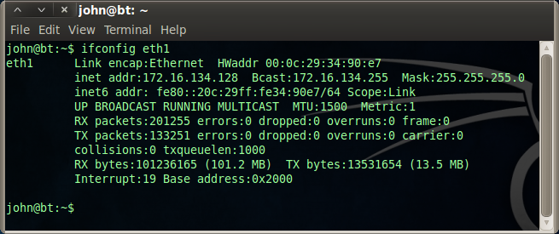
un-synchronization
core local data
ring buffers
read-copy-update (RCU)
Notes:
Consider the simple case of network adapter statistics, as reported by ifconfig. In the screenshot, you’ll see ifconfig reporting reaceived and transmitted packets and bytes.
Older Linux kernels updated these counters with traditional synchronization. Now Linux kernels do this differently. Each CPU core maintains its own list of statistics. They update their own local counters. When they need to be read, then a thread sums up the individual counters to create the result.
This works because reading and writing integers is atomic on all modern CPUs, like x86 and ARM. It’s not possible for one core to read part of an integer while another core writes another part. In other words, allows reporting the correct average packet size can lead to a corrupted, since that’s two separate integers of total bytes divided by total packets, but the individual integers themselves cannot be corrupted.
There are several un-synchronized methods that depend upon the atomicity of reads/writes. This example exploits core local data. Another case is ring-buffers. Another case is the RCU mechanism which you can see examples of in the Linux kernel.

Slide 35
atomics
cmpxchg
lock add
__sync_fetch_and_add()
__sync_bool_compare_and_swap()
Costs one L3 cache transaction (or 30 – 60 clock cycles, more for NUMA)
Notes:
The previous slide discussed how a read or write is atomic, but of course, the classic synchronization is where you want to combined a read and a write together.
All modern CPUs support what are known as ‘atomic’ instructions that allow a read and a write to combined together in one operation that is guaranteed to not be interrupted by another core. Well known examples for x86 code is the compare-exchange instruction. It first tests the value in memory, and if it’s the expected value, swaps it with an updated value. Famously, x86 also allows many arithmetic instructions to be prefixed with a “lock” instruction that makes them atomic.
Of course, you don’t want to get your hands dirty and do assembly yourself. All major compilers support intrinsics that do this for you, such as the family of “sync” functions in GCC.
The cost of this in modern processors is an L3 cache hit, which on Intel processors is between 30 and 60 clock cycles. In other words, a locked add is a hundred times slower than a normal add. You therefore want to use then as little as possible.

Slide 36
“lock-free” data structures
GO
Atomics modify one value at a time
Special algorithms are needed to modify more than one one value together
These are known by many names, but “lock-free” is the best known
Data structures: lists, queues, hash tables, etc.
Memory allocators aka. malloc()
Notes:
Atomics only modify a single value. What happens when you wanted to modify several values together?
The name for this is “lock-free” programming. There’s actually a variation of names, but “lock-free” is the one that you want to remember to anchor you googling.
The most common reason you want to do lock-free is with data structures. A classic example is a hash table. You want to be able to insert items, remove items, or even resize the hash table across a hundred cores in such a manner that no thread has to stop and wait.
Another classic example is a lock-free implementation of malloc(), so that memory allocated by one thread can be freed by another, without either thread having to stop and wait. Microsoft is the worst. The default implementation of malloc() uses a global mutex. Solving this often requires merely linking to a library (that’s what I do in my code).

Slide 37
Be afraid
The ABA problem
You expect the value in memory to be A
…but in the meantime it’s changed from A to B and back to A again
The memory model problem
X86 and ARM have different memory models
Multi-core code written for one can mysteriously fail on the other
Notes:
Your goal should be to use the lock-free methods designed by other people. Doing it yourself is prone to error.
The two most common errors are the “ABA problem” and the “memory model” problem. Before doing your own lock-free algorithms, you should study both of these problems thoroughly.

Slide 38
Threading models
Pipelined – each thread does a little work, then hands off to another
Worker – each thread does the same sort of work, from begin to end
Notes:
Synchronization isn’t your only problem. Another issue is your threading model. There are two fundamental models. The first model is “pipelining”, where each core performs it’s own task/stage and hands off the work to another. A classic example is an IDS. One core might do packet capture. Another core processes the headers. Another core does the pattern-search within the payload. And finally, another core handles events that are produced. Since pattern-searching takes the most amount of time, it may have the most threads allocated to that task.
The other example is peer worker threads, where all threads do the same thing. For example, in an IDS, each thread may pull the next packet from the queue, analyze it, generate events, can go back for more packets.
There are pros and cons to each approach. The pipelined approach requires a lot of synchronization to hand off the work to the next stage, but this likewise means that within a stage, it needs a lot less synchronization. Consider our IDS. Having 16 cores trying to pull packets from the same queue is a lot of synchronization overhead. Maybe it’s better to have a single packet capture thread that then assigns packets to 15 worker queues.

Slide 39
Howto: core per thread
maxcpus=2
Boot param to make Linux use only the first two cores
pthread_setaffinity_np()
Configure the current thread to run on the third core (or higher)
/proc/irq/smp_affinity
Configure which CPU core handles which interrupts
Notes:
Here’s a problem: I want to assign a thread for exclusive access to a core. For example, to meet that “jitter” requirement from C10M, I can’t have any thread interrupted for more than a couple microseconds. Here is the way to do that on Linux. You set the global affinity to mask to use only the first couple CPUs, and then set the affinity mask of each of your threads manually to use the other CPUs. You then set the interrupt mask so that none of your threads will get a hardware interrupt.
The upshot: your threads will NEVER be preempted, not even for a microsecond.

Slide 40
[#3] CPU and memory
at scale, every pointer is a cache miss

Slide 41
20 gigabyte memory
(2k per connection
for 10 million connections)
20meg L3 cache
Notes:
Here is the problem. Today’s computers have a lot of RAM but only small caches. In fact, over the last 15 years, memory size has grown a thousand-fold as you’d expect from Moore’s Law, but caches have remained nearly the same.
Consider only 10-thousand connections and an application that needs 2 kilobytes per connection. That’s 20 megabytes, which fits into the cache of many server processors.
Now consider 10-million connections at 2k per connection. That’s 20 gigabytes. That blows away the cache. These two circles show the correct relative sizes: the bigger circle has a thousand times the area of the smaller circle.

Slide 42
main memory– 300 cycles
L3 cache – 30 cycles
L2 cache – 12 cycles
CPU
L1 cache – 4 cycles
Notes:
RAM is a lie. RAM stands for “random access memory”, but it’s not. You can ignore this lie in normal code because caching hides it from you, but you have to pay attention when writing scalable code.
The problem with memory is that it’s really far away from the CPU. The L1 cache can be accessed in 4 clock cycles. Moreover, since CPUs are pipelined, that 4 cycles can usually be masked from the programmer so that it’s essentially 0 cycles away. The l2 and L3 cache are further away. That’s why you care that atomic operations are an L3 operation – they take 30 cycles.
But main memory is really far away. When the CPU needs to wait on main memory, it can take 300 clock cycles. Note that these aren’t shown at the correct scale, as it’d make things too small.

Slide 43
budget
200 clocks/pkt overhead
1400 clocks/pkt remaining
300 clocks cache miss
-----------------
4 cache misses per packet
Notes:
Why does this matter? It’s because we have a limited budget.
Let’s say we are doing C10M on a 10 core server. That’s 10 million packets per second, according to the definition above. That means each core must do 1 million packets per second. That means a total processing time of 1 microsecond per packet. A cache miss is 100 nanoseconds. That means a total of 10 cache misses per packet.
That may seem like a lot, but it adds up quick, as we’ll see below.

Slide 44
paging
32-gigs of RAM needs 64-megs of page tables
page tables don’t fit in the cache
every cache miss is doubled
solution: huge pages
2-megabyte pages instead of 4k-pages
needs to be set with boot param to avoid memory fragmentation
Notes:
Another of the many technical points you’ve ignored for so long is that user-mode memory is paged. Page contain an 8 byte pointer to each 4096 page. That means for 32-gigs of memory you’ll need 64-megabytes of page tables. This doesn’t fit in the cache. That means every cache miss is doubled.

Slide 45
co-locate data
Don’t: data structures all over memory connected via pointers
Each time you follow a pointer it’ll be a cache miss
[Hash pointer] -> [TCB] -> [Socket] -> [App]
Do: all the data together in one chunk of memory
[TCB | Socket | App]
Notes:
Here’s the problem with Linux. It hashes the IP and port numbers and looks up the result in a hash table. That hash table is just a list of pointers. It follows that pointer to the TCP control block entry. That block then points to a separate socket data structure. An application then has it’s own table of application layer data associated with the socket.
Following each of these pointers is a cache miss. You are looking at a minimum of 4 cache misses per packet.
This could be combined together. Instead of separate TCB, socket, and app structures, combine them altogether in one structure. Instead of a hash table of pointers, create a hash table of the structures themselves. In other words, allocate half the system’s RAM to your TCP entry table. This reduces many cache misses to a single one.

Slide 46
compress data
Bit-fields instead of large integers
Indexes (one, two byte) instead of pointers (8-bytes)
Get rid of padding in data structures
Notes:
You can make your structures smaller. If a number has 10 values, you don’t need 32-bits to store it, but only 4 bits, so use a 4-bit bitfield.
The performance cost is far less than you imagine, and the scalability benefits greater.
Also, this isn’t a portability problem: most of you learned bitfields from Stevens trying to overlay on packets. That doesn’t apply for internal structures.
Pointers are 64 bits. Instead of pointers, you can use indexes and offsets that are fewer bits.
Today’s systems have a lot of padding in data structures that you can get rid of.

Slide 47
“cache efficient” data structures
Notes:
Consider a binary tree. For a tree with a million entries, it takes 20 tests. Now consider how all 20 tests will be cache misses.
The alternative is cache efficient binary trees. A cache line is 64 bytes, which holds 16 32-bit integers. Instead of doing a binary test at each node in our tree, let’s do a linear search of 16 integers. This reduces the 20 cache misses down to 5 cache misses for a million node table.
Consider how a firewall needs to do a lookup of potentially a million firewall rules using prefix matching. Using a cache efficient data structure will be much faster even though technically it should be slower.

Slide 48
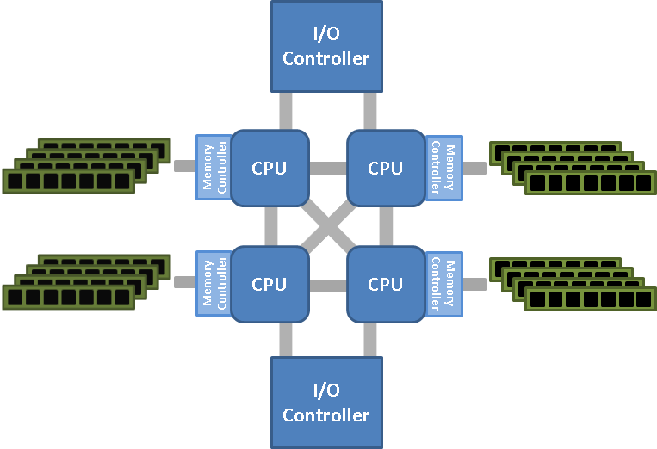
“NUMA”
Doubles the main memory access time

Slide 49
“memory pools”
Per object
Per thread
Per socket
Defend against resource exhaustion

Slide 50
“prefetch”
E.g. parse two packets at a time, prefetch next hash entry
Notes:
You can mask some cache misses.
For example, instead of processing a single packet at a time, grab two. Parse both headers. Execute a “prefetch” on both TCP control blocks. The continue processing the first packet. By the time you get around to processing the second packet, the bytes will be in cache.

Slide 51
“hyper-threading”
Masks the latency because when one thread waits, the other goes at full speed
“Network processors” go to 4 threads, Intel has only 2
Notes:
Intel CPUs have two threads per core. Network processors often have 4 threads. The reason is that when one thread blocks waiting for RAM, the other threads can continue processing what’s in the cache.
The problem with this is that it magnifies your multicore scalability problems. In other words, you have to solve multicore scalability to get memory scalability.

Slide 52
Linux bootparam
hugepages=10000

Slide 53
Data Plane
RAM
CPU
NIC
Control Plane

Slide 54
Takeaways
Scalability and performance are orthogonal
C10M devices exist today
…and it’s just code that gets them there
You can’t let the kernel do you heavy lifting
Byte parsing, code scheduling
Packets, cores, memory
http://c10m.robertgraham.com

