Slide 1
The cost of things at scale
Robert Graham
@ErrataRob
https://blog.erratasec.com

Slide 2
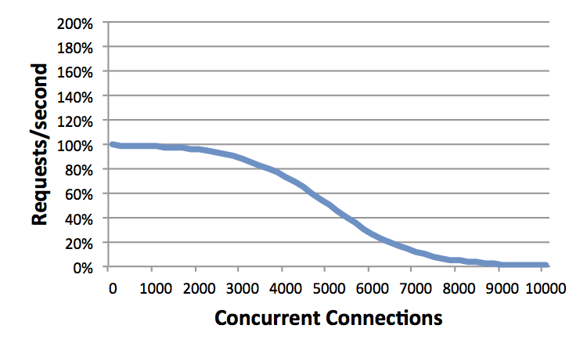
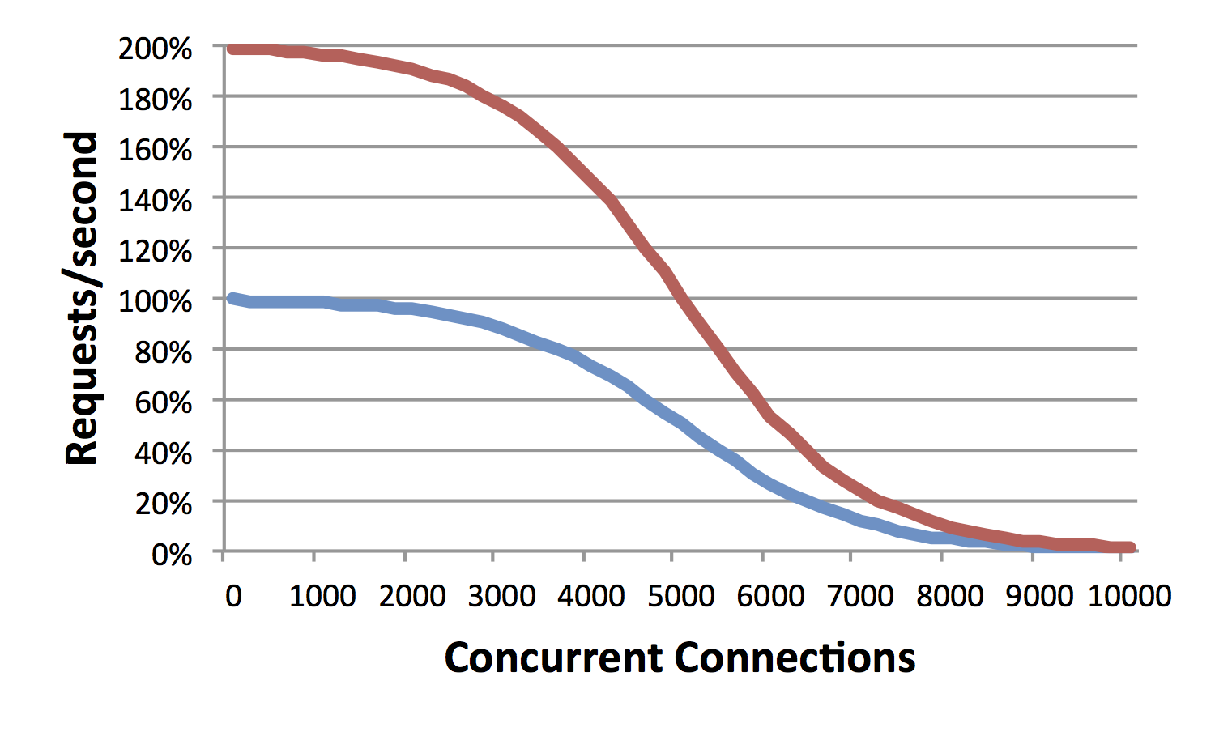
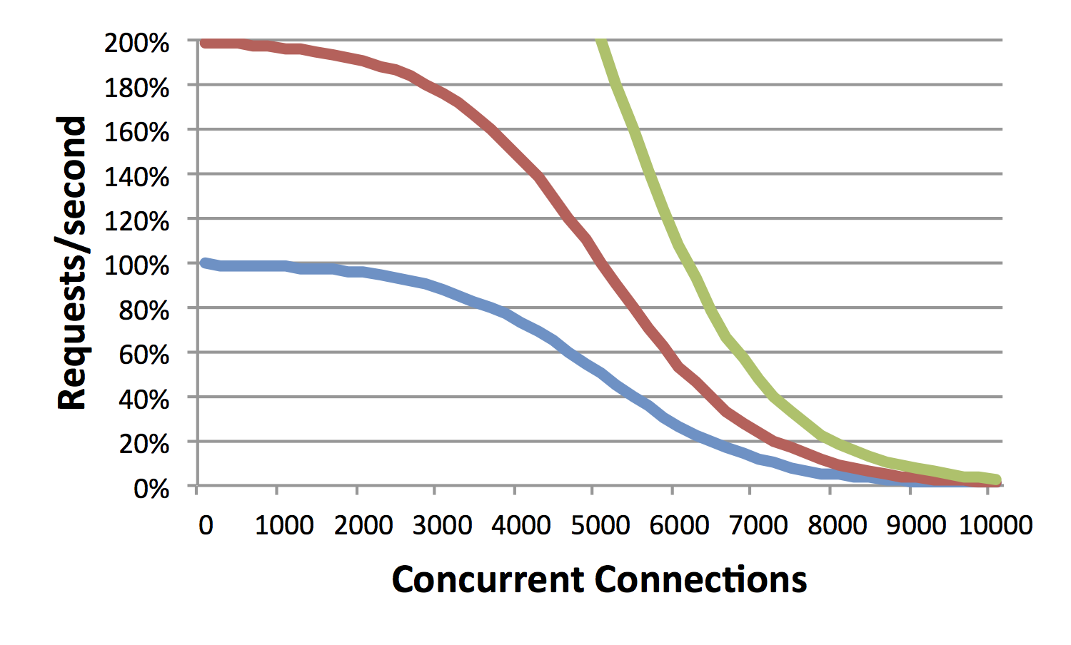
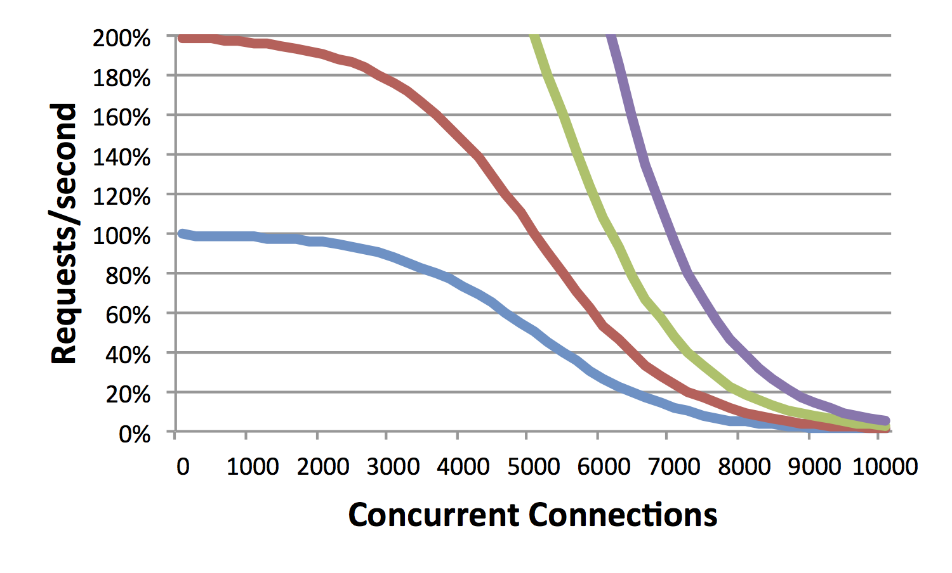
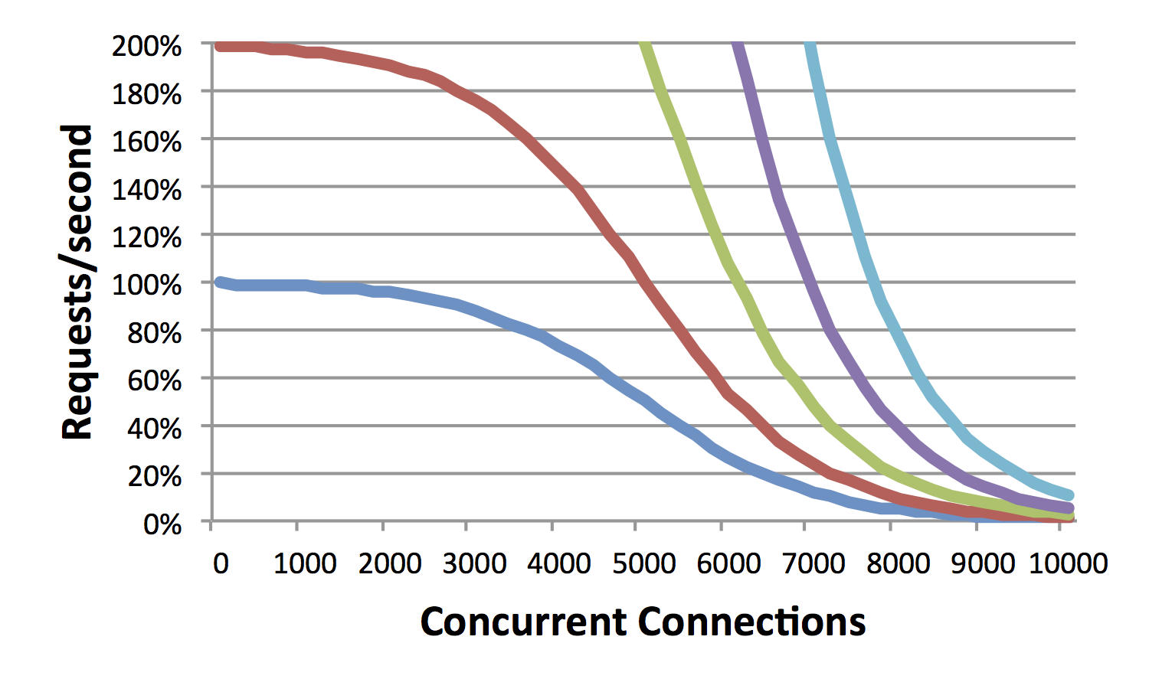
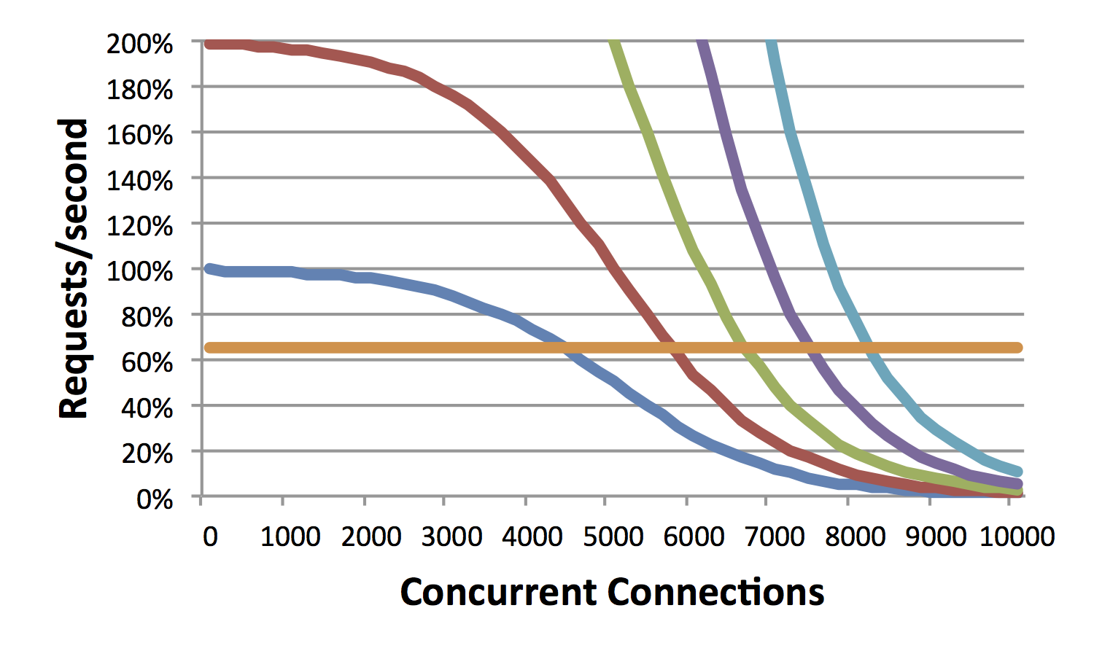
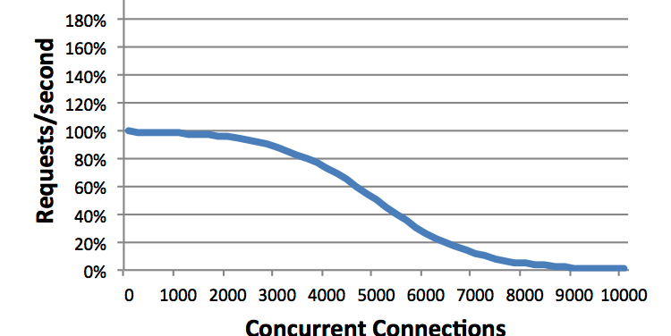
Performance
Scalability
Notes:
[THIS PAGE IS HEAVY ON ANIMATIONS. WATCH THE ANIMATIONS FIRST BEFROE READING THE TEXT]
This talk is about “scalability”, specifically, “Internet scale”. What is “scalability”?
This graph shows a well-known problem with Apache. Normally, we measure performance in “requests per second”. But there is another axis to performance: simultaneous (or “concurrent”) connections. Consider a server that handles 1000 requests per second, and that the server closes the connection immediately after serving the response. If it takes 2 seconds to handle a request, that means there will be 2,000 connections open at any point in time. Likewise, if it takes 10 seconds to handle a connection, then at 1-thousand requests per second, there will be 10,000 concurrent connections on average at any point in time. The problem with Apache is that while it can handle a few thousand open connections, it has trouble with 10,000 open connections. The more concurrent connections, the slower the web server.
Let’s say the server is performing adequately up to 5000 concurrent connections, but we want to handle 10000 concurrent connections. If we upgrade the hardware and double the speed, will that work? The second graph shows this. While we’ve indeed doubled the number of “requests-per-second”, we haven’t doubled “concurrent connections”. W/hereas it handled 5000 before, now it only handles 6000.
The same thing happens when we increase the hardware to be 4x as fast, or 8x as fast, or 16x as fast. At 16 times the speed, we still haven’t reached our target of 10,000 concurrent connections.
What I’m trying to show here is how “performance” and “scalability” are orthogonal to each other. In the rest of this talk you may be confused into thinking that I’m talking about performance, trying to make a computer run faster. I’m not. What I’m talking about is scalability.
This graph reflects the performance of Apache. Let’s instead consider a different web server called “nginx”. Nginx doesn’t reach its scalability limits until around 100,000 or even 1-million concurrent connections. On our graph, this appears as essentially a flat line out to 10,000. Consider running a high-end website like YouTube. Running nginx on this laptop (which is slow) at 10,000 concurrent connections will vastly outperform a high-end 16 CPU server system running Apache. Sure, as the left-hand side of the graph shows, this laptop would be a lot slower than a single-CPU server when the number of simultaneous connections is small, but as the right hand side of the graph shows, it vastly out peforms as the problem scales.
This graph shows one scalability problem, spe, specifically, how Apache fails at handling lots of concurrent connections. Most connections are short duration. The point from when the connection is opened, the data transferred, and then closed lasts only a second. Thus, a website may handle thousands of requests per second, but at any time, have only a few connections open.
But in some cases, requests take longer to complete, and connections stay open longer. Consider a website that handles 1000 requests/second, but where it takes on average 10 seconds to complete each request. That means at any point in time around 10,000 connections will be open.

Slide 3
The cost of things
How fast can CPUs execute instructions
How fast can CPUs access-memory
How fast are kernel system calls
How fast are synchronization primitives
How fast are “context-switches”

Slide 4
Code
https://github.com/robertdavidgraham/c10mbench

Slide 5
C10M defined
10 million concurrent connections
1 million connections/second
10 gigabits/second
10 million packets/second
10 microsecond latency
10 microsecond jitter
10 coherent CPU cores
Notes:
Whereas Apache fails at 10k connections, nginx fails at 100k connections. This talk is about reach 10 million concurrent connections.
But my goal with C10M is to define a broader set of scalability issues. At high networks speeds, there are issues with connections rates, bit rates, and packet rates. At scale, it becomes hard to maintain low latency, as well as dealing with max latency (known as jitter). CPUs haven’t gotten faster in the last decade, instead, we’ve been getting multiple CPU cores on a chip. This is its own scalability issues.
Notice that I’ve rounded everything to the nearest order of magnitude, base 10. These will vary slightly. My own code handles 30 million concurrent connections, but can only sustain 800k connections per second. Competing code reverse this, not quite handling as many concurrent connections, but having higher connection rates.
All these numbers refer to what’s achievable on standard x86 computers.

Slide 6
Classic definition: Context-switch
Process/thread context switches

Slide 7
..but process context switches becoming rare
NodeJS
Nginx
Libevent
Java user-mode threads
Lua coroutines

Slide 8
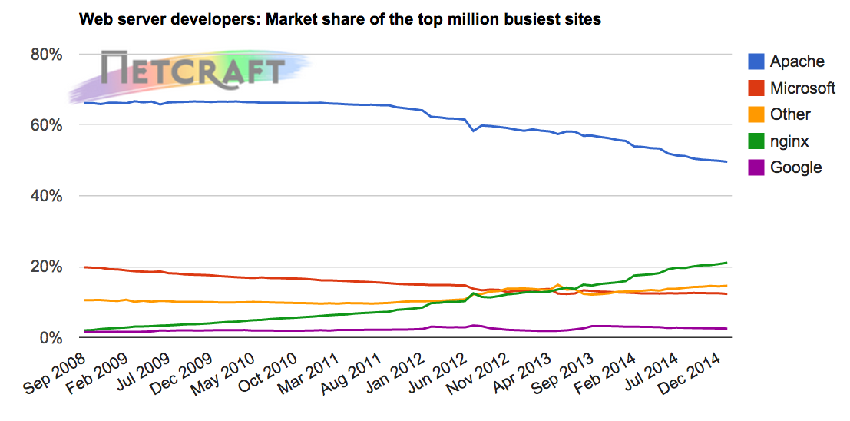
…but context switches becoming rare
.

Slide 9
Real definition: Context-switch
Each TCP connection is a task, with context
  Whether you assign a thread to it, a closure, or a data structure
Each incoming packet causes a random context switch
A lot of small pieces of memory must be touched – sequentially
  “pointer-chasing”

Slide 10

.

Slide 11
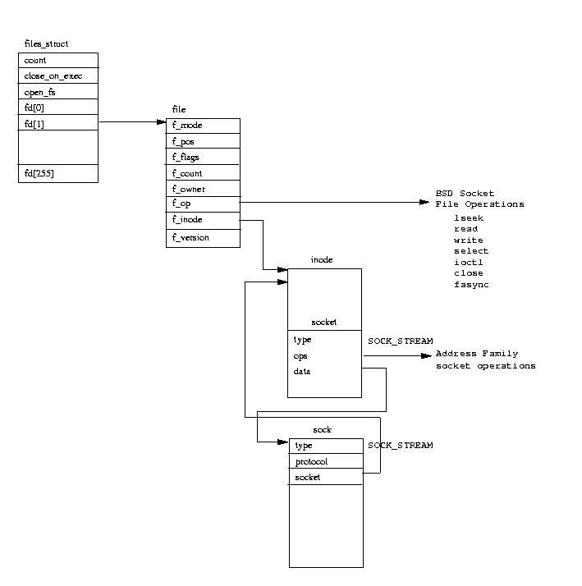

Slide 12
main memory– 300 cycles
L3 cache – 30 cycles
L2 cache – 12 cycles
CPU
L1 cache – 4 cycles
Notes:
RAM is a lie. RAM stands for “random access memory”, but it’s not. You can ignore this lie in normal code because caching hides it from you, but you have to pay attention when writing scalable code.
The problem with memory is that it’s really far away from the CPU. The L1 cache can be accessed in 4 clock cycles. Moreover, since CPUs are pipelined, that 4 cycles can usually be masked from the programmer so that it’s essentially 0 cycles away. The l2 and L3 cache are further away. That’s why you care that atomic operations are an L3 operation – they take 30 cycles.
But main memory is really far away. When the CPU needs to wait on main memory, it can take 300 clock cycles. Note that these aren’t shown at the correct scale, as it’d make things too small.

Slide 13
20 gigabyte memory
(2k per connection
for 10 million connections)
20meg L3 cache
Notes:
Here is the problem. Today’s computers have a lot of RAM but only small caches. In fact, over the last 15 years, memory size has grown a thousand-fold as you’d expect from Moore’s Law, but caches have remained nearly the same.
Consider only 10-thousand connections and an application that needs 2 kilobytes per connection. That’s 20 megabytes, which fits into the cache of many server processors.
Now consider 10-million connections at 2k per connection. That’s 20 gigabytes. That blows away the cache. These two circles show the correct relative sizes: the bigger circle has a thousand times the area of the smaller circle.

Slide 14
Measured latency: 85ns

Slide 15

budget
10 million packets/second
divided by 10 cores
by 100 nanoseconds/miss
-----------------
~10 cache misses per packet
Notes:
Why does this matter? It’s because we have a limited budget.
Let’s say we are doing C10M on a 10 core server. That’s 10 million packets per second, according to the definition above. That means each core must do 1 million packets per second. That means a total processing time of 1 microsecond per packet. A cache miss is 100 nanoseconds. That means a total of 10 cache misses per packet.
That may seem like a lot, but it adds up quick, as we’ll see below.

Slide 16
Now for user-mode
Apps written in C have few data structures
Apps written in high-level languages (Java, Ruby, Lua, JavaScript) have bits of memory strewn around

Slide 17
User-mode memory is virtual
Virtual addresses are translated to physical addresses on every memory access
  Walk a chain of increasingly smaller page table entries
But TLB cache makes it go fast
  But not at scale
  TLB cache is small
  Page tables themselves may not fit in the cache

Slide 18
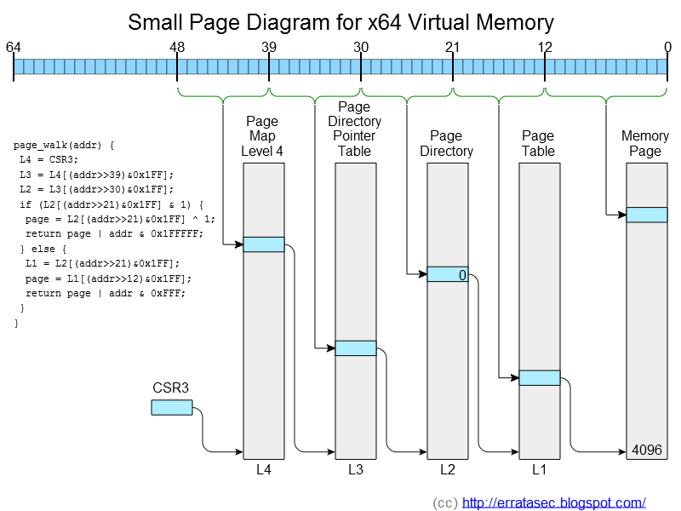
.

Slide 19
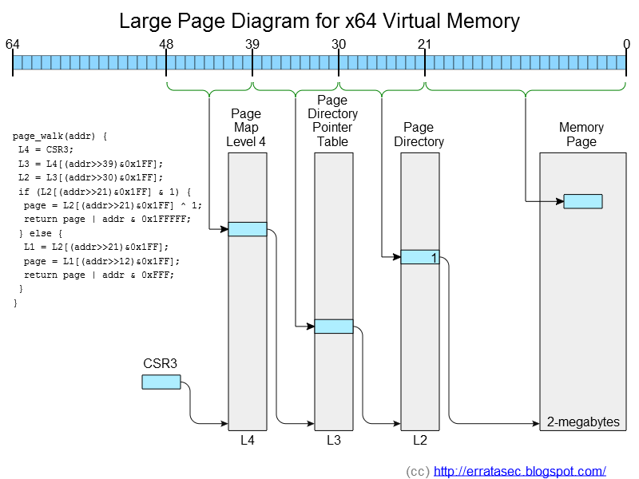
.

Slide 20
20 gigabyte memory
(2k per connection
for 10 million connections)
10k hugepage tables
20meg L3 cache
40meg small page tables
Notes:
Here is the problem. Today’s computers have a lot of RAM but only small caches. In fact, over the last 15 years, memory size has grown a thousand-fold as you’d expect from Moore’s Law, but caches have remained nearly the same.
Consider only 10-thousand connections and an application that needs 2 kilobytes per connection. That’s 20 megabytes, which fits into the cache of many server processors.
Now consider 10-million connections at 2k per connection. That’s 20 gigabytes. That blows away the cache. These two circles show the correct relative sizes: the bigger circle has a thousand times the area of the smaller circle.

Slide 21
User-mode latency

Slide 22
QED:
Memory latency becomes a big scalability problem for high-level languages

Slide 23
How to solve
Hugepages to avoid page translation
Break the chain
  Add “void *prefetch[8]” to the start of every TCP control block.
  Issue prefetch instructions on them as soon as packet arrives
  Get all the memory at once

Slide 24
Memory access is parallel
CPU
  Each core can track 72 memory reads at the same time
  Entire chip can track ?? reads at the same time
DRAM
  channels X slots X ranks X banks
  My computer: 3 * 2 * 1 * 4 = 24 concurrent accesses
  Measured: 190-million/sec = 15 concurrent accesses

Slide 25
Some reading
“What every programmer should know about memory” by Ulrich Draper
http://www.akkadia.org/drepper/cpumemory.pdf

Slide 26
Multi-core

Slide 27
Multi-threading is not the same as multi-core
Multi-threading
  More than one thread per CPU core
  Spinlock/mutex must therefore stop one thread to allow another to execute
  Each thread a different task (multi-tasking)
Multi-core
  One thread per CPU core
  When two threads/cores access the same data, they can’t stop and wait for the other
  All threads part of the same task
Notes:
The historic computer problem was “multi-tasking”. Computers had only a single CPU core that had to be split among many tasks.
Today’s problem is different. Today we have a single task we want to split across many cores.
You learned computer science according to the old problem, but today you have to unlearn multi-threaded programming and learn multi-core programming.

Slide 28
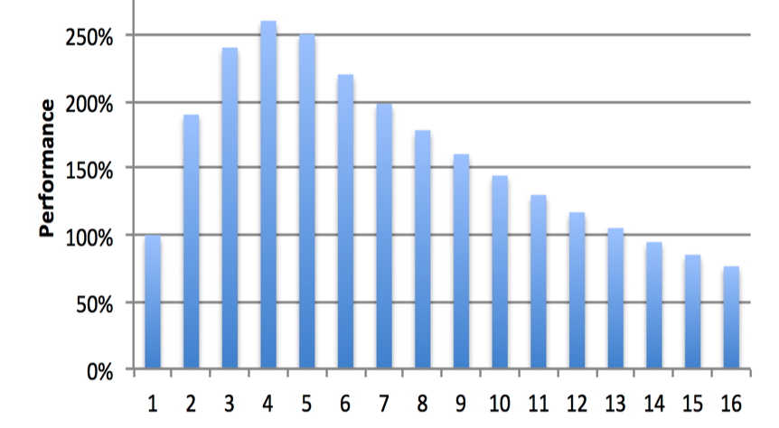
Most code doesn’t scale past 4 cores
Notes:
This hypothetical graph shows how most multithreaded code scales. Adding a few CPU cores makes the code go faster, but it quickly reaches a peak, after which adding more code actually makes the code slower. This is why mobile devices max out at 4 cores – very little software exists that can adequately take advantage of more cores.
TODO: grep mutex/spinlock Apache source tree

Slide 29
#1 rule of multi-core: don’t share memory
People talk about ideal mutexes/spinlocks, but they still suffer from shared memory
There is exist data structures, “lock free”, that don’t require them

Slide 30
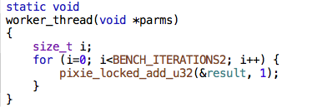
Let’s measure the problem
A “locked add” simulates the basic instructions behind spinlocks, futexes, etc.

Slide 31
Total additions per second

Slide 32
Latency per addition per thread

Slide 33
Two things to note
~5 nanoseconds
  Cost of an L3 cache operation (~10ns)
  Minus the out-of-order execution by the CPU (~5ns)
  …and I’m still not sure
~100 nanoseconds
  When many thread contending, it becomes as expensive as a main memory operation

Slide 34
Syscalls
Mutexes often done with system calls
So what’s the price of a such a call?
  On my machine
  ~30 nanoseconds is minimum
  ~60 ns is more typical idealized cases
  ~400 ns in more practical cases

Slide 35
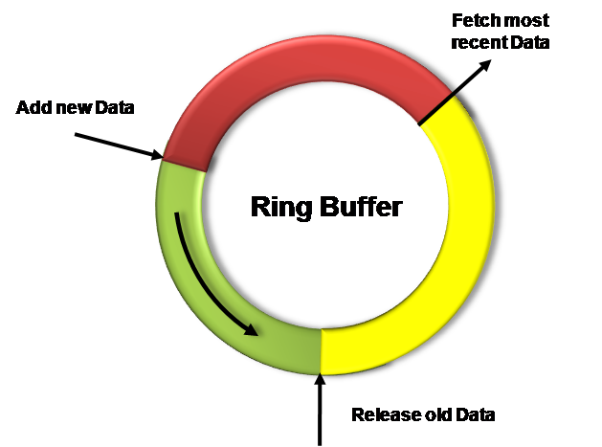
Solution: lock-free ring-buffers
No mutex/spinlock
No syscalls
Since head and tail
are separate, no sharing
of cache lines
Measured on my machine:
  100-million msgs/second
  ~10ns per msg

Slide 36
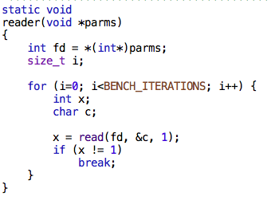
Shared ring vs. pipes
Pipes
  ~400ns per msg
  2.5 m-msgs/sec
Ring
  ~10ns per msg
  100 m-msgs/sec

Slide 37
Function call overhead
~1.8ns
Note the jump for “hyperthreading”
  My machine has 6 hyperthreaded cores
6 clock cycles

Slide 38
DMA isn’t
CPU
L3 cache

Slide 39
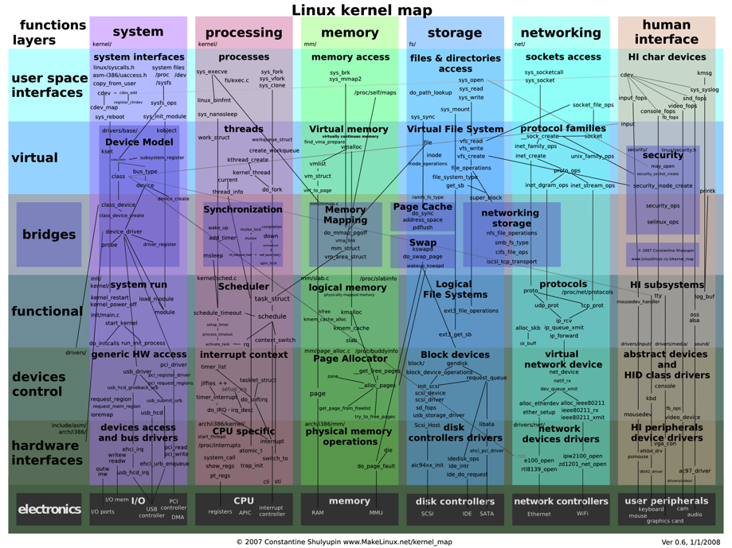
Notes:
This picture shows the complexity of the Linux kernel. When a packet arrives, it goes through a torturous route through the Linux networking stack. When you are using the Apache model with processes, the path the packet takes becomes even more complex.
There’s an alternative to this. Instead of using Linux, you can write your own packet driver for a hardware card. This card ships the packets directly to your application with zero overhead.

Slide 40
Where can I get some?
PF_RING
  Linux
  open-source
Netmap
  FreeBSD
  open-source
Intel DPDK
  Linux
  License fees
  Third party support
    6WindGate
Notes:
A lot of companies have written their own proprietary drivers to do this. That’s what we did for BlackICE 15 years ago.
These days, there are two primary sources to look at. The best known open-source solution is PF_RING, though I think there are alternatives if you look hard enough. The best known commercially licensed alternative is the “Intel DPDK”, though there are others as well.
There are also companies like Napatech that try to sell you special network cards with hardware acceleration. As far as I can tell, they are mostly snakeoil.

Slide 41
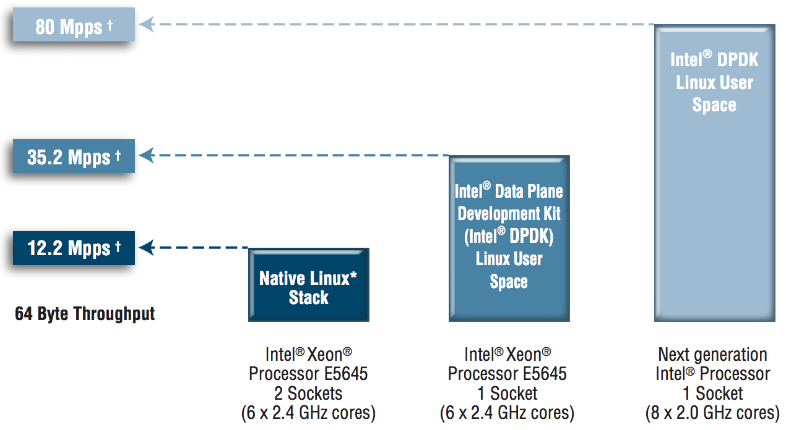
200 CPU clocks per packet
http://www.intel.com/content/dam/www/public/us/en/documents/solution-briefs/communications-packet-processing-brief.pdf
Notes:
Here are the benchmarks according to Intel. Using their DPDK, they achieve an 80 million packet per second forwarding rate. That’s roughly 200 clock cycles per packet.
What’s strange about this benchmark is that it understates their advantage. That’s packet delivered all the way to userspace and back again, in 200 clock cycles. The equivalent Linux test keeps all the packet sin the kernel. Trying to get those packets to user space, such as with libpcap, drops that rate to less than a million packets/second. I can’t figure out how to get Linux to go faster than 1-million packets/second.
When budgeting for a C10M application, you can assume 200 clock cycles to receive and retransmit a packet. At a rate of only 10 million packets/second, that leaves a budget of 1800 clock cycles per packet.

Slide 42
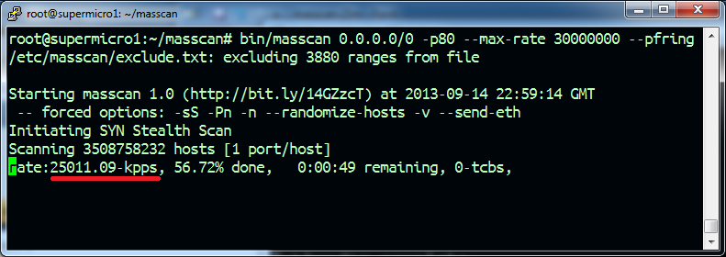
masscan
Quad-core Sandy Bridge 3.0 GHz

Slide 43
Premature optimization is good
Start with prototype that reaches theoretical max
  Then work backwards
Restate the problem so that it can be solved by the best solutions
  Ring-buffers and RCU (read-copy-update) are the answers, find problems solved by them
Measure and identify bottlenecks as they occur

Slide 44
Raspberry PI 2
900 MHz quad core ARM w/ GPU

Slide 45
Memory latency
High latency
Probably due to
limited TLB
resources
Didn’t test max
outstanding transactions, but should be high for GPU

Slide 46
Cache Bounce
Seems strange
No performance
loss for two threads
Answer: ARM Cortex-A8 comes in 2-cpu modules that share cache

Slide 47
Compared to x86
 | ARM | x86 | Speedup
Hz | 0.900 | 3.2 | 3.6
syscall | 0.99 | 2.5 | 2.6
funcall | 59.90 | 556.4 | 9.3
pipe | 0.17 | 2.5 | 14.8
ring | 3.90 | 74.0 | 19.0
.

Slide 48
Todo:
C10mbench work
  More narrow benchmarks to test things
  Improve benchmarks
  Discover exactly why benchmarks have the results they do
  Benchmark more systems
    Beyond ARM and x86

