Slide 1
Intel x86 Hardware Security Primitives
“What tools are in the tool-chest?”
Mr. Jacob Torrey
February 28, 2017
Dartmouth College
@JacobTorrey
torreyj@ainfosec.com
Linkedin.com/in/jacobtorrey

Slide 2
Introduction
In efforts to ease system consolidation and optimize resource use, Intel (and ARM, AMD…) have provided hardware extensions to support hardware-backed security and virtualization of disparate OSes on a single physical machine
This lecture aims to provide a short introduction to these extensions and how to utilize them in future research (there is a lot of emergent/weird machine behavior here)
Slides will be provided for reference, please don’t hesitate to jump in with questions at any time

Slide 3
Full vs. Paravirtualization
In this talk, focus will mostly be on full virtualization
  Guest OS is unmodified, generally thinks it is running without VMM
Paravirtualization is where modifications to the guest OS are made to simplify
  For example: disk driver talks to VMM directly, rather than trapping on MMIO/PIO requests
  PV drivers still used on fully virtualized VMMs for speed and management advantages
Intel VT-x enables full virtualization
  From architecture side, more interesting (to me at least)

Slide 4
Outline
Gap Analysis – From OS to VMM
Technical Overviews
  General architecture
  Memory management/isolation
  VMCS mechanics
  Exit conditions
  VMM Weirdnesses
  Asides: TXT & SMM/STM
Interesting Research
  Recovering private keys from VM side-channels
  MoRE – VT-x + TLB splitting
  HARES – VT-x + TLB splitting + AES-NI
Concluding Remarks
Questions

Slide 5
Gap Analysis
“Ring 0 to Ring -1”
In short, a virtual machine monitor (VMM aka hypervisor) is a kernel where OSes are ‘applications’
  Can abstract memory (guest physical addresses to machine physical)
  Multiplex between OSes and trap on specified exceptions/violations
  Provide a consistent & abstracted view of hardware
Well-designed architecture (mostly) cleans a lot of cruft needed for legacy support
  Originally no support for real-mode
  64-bit aware, no PAE needed
  Allows VMM to be very small code base

Slide 6
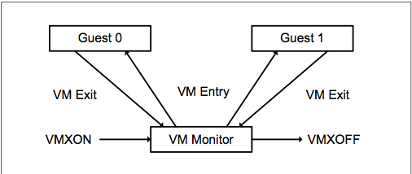
VT-x in a Figure
Shows VMM ‘slot’, and the process for transitioning to and from from multiple guests
From Intel SDM 3C – Official VT-x specification document

Slide 7
The Growth of VMMs
Many single OS systems now are VMs
Hyper-V comes by default installed on Win 8+
  Required in Win 10
Linux KVM is merged with kernel mainline
The line between guest, host and VMM is increasingly blurred
  Host OS is more privileged than VMM userspace
  Host OS is less privileged than VMM root

Slide 8
Technical Overview
General Architecture
Separated into VMX root and non-root mode
  VMXON, VMXOFF and VM Exits/Enters switch between two modes
  Can be initiated from either Ring 0 or SMM (“Ring -2”)
VMM sets up task_struct-like VM control structure (VMCS) for each VM
  Specifies what events will trigger VM Exit
Some events always trigger VM Exit
  CPUID, RDTSC, etc…
  Can be used to determine if a OS is being maliciously virtualized

Slide 9
Technical Overview
General Architecture II
VMM is protected from rogue guests, and guests benefit from some protections from each other
  Performance and cost were driving factors in implementation
Couples with other Intel technologies for greater assurances
  VT-d: Prevents hardware devices from DMAing memory to arbitrary memory
  TXT: Allows a measured launch of a hypervisor at any point and creates a dynamic root-of-trust
  EPT/VPID: Allows hardware to take a bigger role in memory and cache separation and management

Slide 10
Technical Overview
VMM Architecture
VMMs are either Type-I or Type-II
Examples of Type-I
  Xen, VMWare ESX, Hyper-V
Examples of Type-II
  VirtualBox, KVM, VMWare Player
Guest
Guest
Guest
Guest
Hypervisor
Hypervisor
Host Operating System
Hardware
Hardware

Slide 11
Technical Overview
VMM Architecture II
Different types lead to different hardware multiplexing models
Type-I VMMs generally have a control domain (dom0) which can directly talk to hardware and multiplex all requests from guests – don’t want to need drivers in VMM
  More secure and isolated, no full OS in TCB
Type-II VMMs use the hardware drivers of host OS
  Simpler to install, just an application on host OS

Slide 12
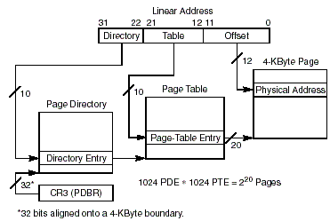
Technical Background
Virtual Memory
Paging provides an operating system with a means to organize physical memory while at the same time, providing executables with an abstracted, contiguous view of memory
Viralpatal.net

Slide 13
Technical Overview
Page Translation
Every memory access requires several memory bus transactions to perform page translation
  This is slow!
CPU
Memory
Get PD Entry
PD Data
Get PT Entry
PT Data
Get Memory
Memory Data

Slide 14
Technical Overview
Translation Lookaside Buffer
The solution to this problem is to cache previous translations in a buffer called the Translation Lookaside Buffer (TLB)
Access Memory
Is Translation in TLB?
No
Get PDE
Get PTE
Cache
Yes
Get Memory

Slide 15
Technical Overview
Memory Management
Extended page tables (EPT) adds additional levels to traditional virtual memory hierarchy
  Maps “guest physical” to “machine physical”
  Triggers EPT Fault VM Exit instead of page fault
  Allows OS to manage memory without VMM interference
  Implements new instructions similar to INVLPG
VM process ID (VPID) adds a word to each TLB line with the VM ID (VMM = ID 0) to prevent performance hit from VM Exit TLB flush

Slide 16
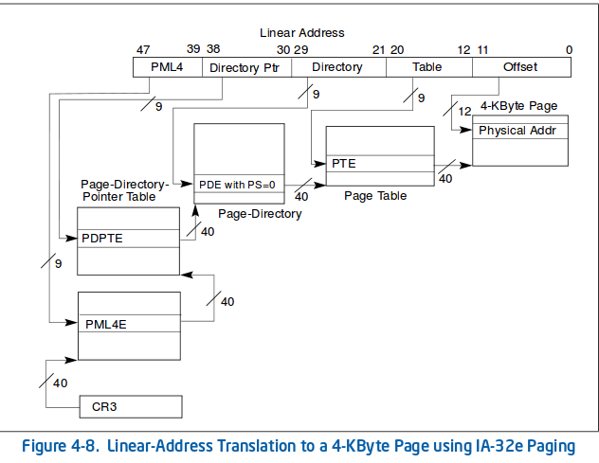
Back to Paging

Slide 17
Technical Overview
VMCS Mechanics
Think of a VMCS as a task state segment (TSS) or task_struct for OS VMs
One VMCS PTR per processor, points to currently active VMCS
VMCS stores guest and host state, exit conditions and pointers to other related structures
  EPT Pointer points to PML4 for VM
Not directly accessible to memory reads/writes, requires a specialized instruction to access (VMREAD/VMWRITE)

Slide 18
Technical Overview
VM Exit Conditions
Among others, the VMCS can be configured to trap on:
  Interrupts
  Memory faults (akin to page faults)
  IO access (port IO)
  Certain privileged instructions
    MOV to control registers
    RDMSR/WRMSR
    RDRAND
    Etc…
When trapping to VMM, provides all guest registers/state and exit condition

Slide 19
VMM Weirdness
#VE
#VE is a new specification that allows for some EPT faults to be routed to ring-0’s INT20
Allows kernel to switch between a VMM-approved list of EPTPs without transitioning to VMX-root mode for performance reasons
  Allows rapid VM introspection with less performance impact
Currently only for (some) EPT faults, more probably coming

Slide 20
VMM Weirdness
Shadow VMCS
“Nested virtualization” is the name for running a hypervisor within a hypervisor (VMMception?)
Originally done through emulation of the nested VMMs attempted changes to VMCS/EPT
  Trap to root VMM on VMREAD/VMWRITE, etc.
Now CPUs support “Shadow VMCS”, where VMREAD/VMWRITE in VMX non-root mode will not trap to VMM
  Allows inner VMM to manage VMs
  Much less performance impact

Slide 21
Technical Aside
TXT & SMM
Intel trusted execution technology (TXT) provides the ability to establish a dynamic root-of-trust
  Sets TPM (hardware crypto co-processor) into special mode as well as CPU(s) and launches measured launch environment
  Removes legacy BIOS and additional untrusted software from trusted computing base (TCB)
Intel Software Guard extensions (SGX) provides “enclaves”
  Newer, more “nimble” TXT
Intel system management mode (SMM) is a stealthy execution environment (“ring -2”) for chipset manufacturer code to live
  Fully hidden in HW from OS/hypervisor
  Can host a 2nd VMM that virtualizes chipset code (DMM)

Slide 22
Interesting Research
Private key side-channel leakage
VT-x may provide strong isolation, but side-channels still exist
  Timing
  Shared processor cache
  IO
  CPU Pipelining
Extracted a private key being used in a VM from another co-resident VM on the Xen hypervisor
  Used cache timing (similar to AES attack) to figure out what memory other VM was accessing
  Able to recover ElGamal private key in lab setting
Reminder that VT-x is not designed for total isolation

Slide 23
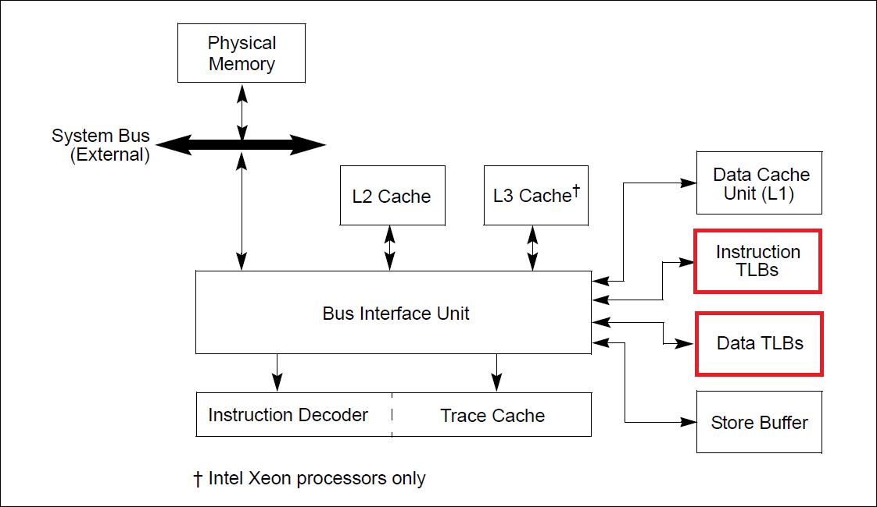
Technical Background
TLB
TLB is physically two separate entities, one for code, one for data

Slide 24
Interesting Research
Measurement of running executables
Built upon GRSecurity’s PAGEEXEC & Shadow Walker rootkit to split TLB to provide periodic measurements of dynamic code applications
Transparently segregates code and data fetches to different regions of memory
Can detect code-injection attack almost instantly
DARPA Cyber Fast Track effort

Slide 25
AES-NI
In response to software-based caching attacks on AES, Intel released instruction set to support AES
Hardware logic is faster, and more protected
Supports 128-bit and 256-bit AES
Provides primitives, still requires engineering to make a safe system on top of these

Slide 26
Interesting Research
Hardened Anti-Reverse Engineering System
Built upon MoRE to split TLB to provide an AES-NI/TRESOR encrypted capability
  AES key stored in CPU debug registers
Transparently segregates code and data fetches to different regions of memory
Data fetches are routed to encrypted pages, preventing reverse-engineering
Instruction fetches are routed to decrypted execute-only pages for seamless execution

Slide 27
Concluding Remarks
Hopefully this provided enough of an overview of Intel VT-x for you to feel confident to play with it
I have a simple hypervisor which I built on for MoRE for anyone who is interested
  https://github.com/ainfosec/more
AIS’s Bareflank is a VMM designed for easy bootstrapping of research hypervisors
  https://bareflank.github.io/hypervisor/
Don’t hesitate to contact me with questions or to bounce ideas around

Slide 28
Questions?
Bedankt!

