Slide 1
Dartmouth CS258bis:
Advanced Userlands
The anti-kernel
(Questions preferred – please interrupt and ask)

Slide 2
About this talk
OS principles
  For doing things the OS wants you to do
  Sound engineering principles in general
User-land principles
  For breaking the rules
  Sound engineering principles in general
Notes:
Leveraging the operating-system is just one way of getting things done.
For truly high-performance, scalable code, you need to do things yourself. Many of the concepts about how the operating system was written will help, but you also need to go into new areas of engineering. This paper contrasts doing things in user-land without the operating system, with what was learned as standard operating system concepts..

Slide 3
What OS does for you
Locks (spinlocks, mutexes)
IPC
Processes/threads/scheduling
Memory allocation
Security
Network stack
Notes:
Here are some of the concepts you learn in an “advanced operating system” class. You’ll learn the evolution of these things as they’ve gotten better over time. You’ll learn the tradeoffs made by different operating systems, which do things slightly differently.

Slide 4
What you can do for yourself in userland, better
Locks (spinlocks, mutexes)
IPC
Processes/threads/scheduling
Memory allocation
Security
Network stack
Notes:
I’m going to talk about the same concepts, only this time instead of contrasting how different operating systems do it, I’m contrasting with how they can be done in user-land, bypassing the operating system kernel completely.

Slide 5
Contrast: spinlocks/mutexes
What you were taught: better locks
What you need to know: no locks
  Linux kernel rapidly getting rid of spinlocks
  Replacing with RCU and other lock-free/wait-free techniques
Notes:
You go through phases.
Phase one you were taught to use locks to avoid corrupting data
Phase two you learned better locks, like better designs in the operating system
Phase three you learn to get rid of locks.
The problem is that locks don’t scale with many CPUs vying for access. What you learned about locks in Solaris when microseconds where acceptable for lock latency. Now it’s nanoseconds that’s required.
You see this in the evolution of Linux which is rapidly getting rid of spinlocks in it’s core. They are being replaced with lock-free techniques, most noticeably RCU. RCU scales well with a zillion cores.

Slide 6
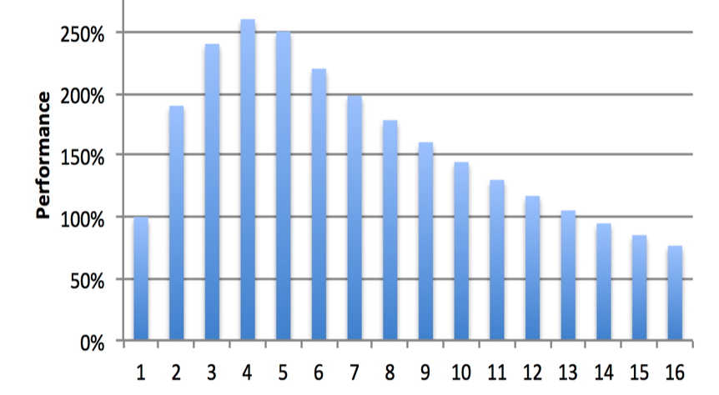
Most code doesn’t scale past 4 cores
Notes:
This is a graph of how most multi-core software works. After a few cores, adding more makes it go slower. That’s because of contention around locks.

Slide 7
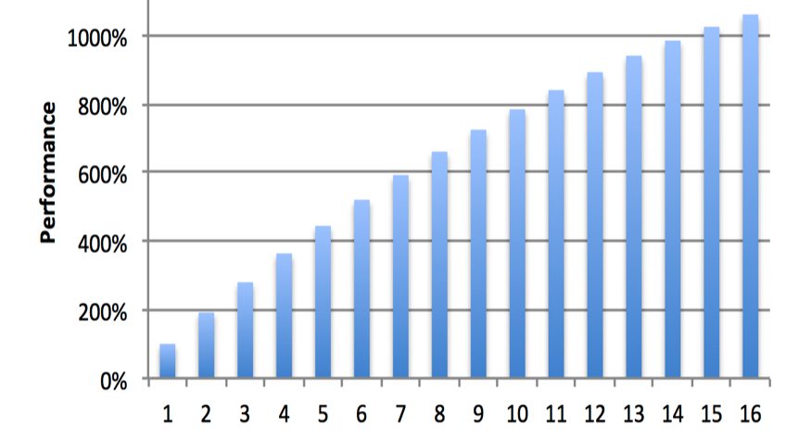
At Internet scale, code needs to use all cores
Notes:
What we want is a graph like this, such that adding cores make software go faster. You can’t have 16 cores running full out if they are contending for the same locks.

Slide 8
Reads OR writes are atomic
Reading an aligned integer from memory is always an atomic operating
  You’ll never get a partial integer
  On any CPU
Same with writes
Notes:
One of the surprising things about CPUs is the fact that a write, or a read, is atomic, as long as it’s aligned on an even boundary (nd sometimes when it’s not aligned). That means you can read an integer, safe in the knowledge that you haven’t read half the bytes in the integer.
The deal wit hsynchronization is that the combination of a read and a write is not atomic, that between reading and writing, something else may have happpened in the system that changes values. For that, you need “atomic” read/write instructions.
But the basic read/writes themselves can do some of the synchronization stuff for us.

Slide 9
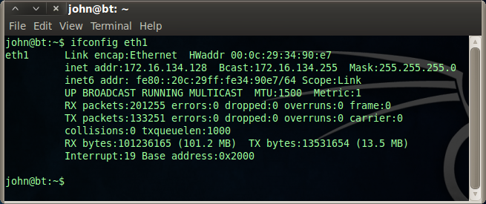
Example: network interface stats
Notes:
An example of this is how Linux updates performance counters for the network stack. Ever time a packet arrives, it updates the “Rx” count, for number of packets, as well as number of bytes. Same thing on transmit. (Tx).
In Linux 2.4, these counters were updated with a spinlock, so that whichever CPU received a packet could update the global cunters without corrupting them.
In Linux 2.6, this was changed. Instead, each CPU maintains it’s own counters. When you do an ‘ifconfig’, then a thread grabs all the counters from all the CPUs and adds them together. This works with no corruption.

Slide 10
Read-Copy-Update
How it works
  Make a copy of a data structure
  Make all your changes
  Replace the pointer, to your new one vs old one
  Wait until all threads move forward
    Now point to new data structure
  Free old data structure
Non-blocking
  …for readers
  …only one writer/changer at a time
Notes:
RCU works without any “synchronization”.
It works by first making a copy of a data structure that needs changes.
When done, it replaces the pointer that all threads use for that data structure.
It then has to wait until all threads move forward, to a point where we know nobody has a pointer to the old structure.
Then we delete the old structure.
Since reads/writes of (aligned) pointers are atomic, no special synchronization is needed.

Slide 11
RCU in DNS server
Pointer to DNS database
Receive threads do
  Read packet
  Get pointer to database
  Process/send response
When updating DNS database
  Swap pointer to new database
  Wait for all receive threads to get new packet
  Free old pointer tol old database
Notes:
This is how I do it on my DNS server, where the worker threads processing DNS requests may be operating from and old or new database of names. I have to wait until all threads have moved forward before I can delete the old database.
My IDS works in a similar same way. I read in new IDS signatures into a database, replace the pointer, then wait. However, the waiting period is a little weird. I have to wait until all TCP connections using the old database are freed up. Many signature databases can be active at the time same. Only when all TCP connections have been freed for a database will the database be freed.

Slide 12
Non-blocking algorithms
“Lock-free”
  At least one thread makes forward progress
“Wait free”
  All threads make forward progress
  Upper bound to number of steps any thread make make

Slide 13
Non-blocking algorithms
Built from primitives
  CAS, CAS2, cmpxchng16b, LL/SC, lock add
  Intel TSX
Common data structures
  Queues
  Hash-tables
  Ring-buffers
  Stacks, sets, etc.
Notes:
This slide is a big one that probably needs to be separated into multiple slides.
The basic primitive for many lock-free algorithms is the “compare-and-swap”, which on the x86 would be the cmpxchng instruction. This takes as input two values, the expected value at a memory location, and the new value. If the current and expected value matches, then a swap with the new value occurs.
A lot of algorithms, though, work better being able to compare-and-swap two values at once, called CAS2. On Intel x86, this is known as the cmpxchng16b instruction. It compares 16 bytes at once, meaning two 64-bit values (such as two pointers). It’s not a generic CAS2 as it requires the two values to be adjacent in memory, but it’s close enough.
Intel’s TSX reserves multiple cache lines, then sets a start point, then executes a few instructions on those cache lines. If any other CPU reads/writes those cache lines, our CPU is set back to the start point to try again. You can think of it as cmpxchng64b.
Out of these basic primitives you can create data structures, like queues and hash-tables. The TSX implementation of a hash-table allows enormous scalability across a lot of cores.
What I do is select the data structure first that performs well, then wrap my code around it. E.g. an IDS TCP table that uses a TSX-based hash-table.

Slide 14
Be careful writing your own
ABA problem
  cmpxchg succeeds, even though a change has occurred
Weak-memory consistency on non-x86 processors
  Needs more memory barriers

Slide 15
Performance tradeoffs
You need to select the lock-free data structure that fits your needs
  How frequent will contention be?
  How many readers/writers?
  Theoretical wait-free or lock-free?
Sometimes the traditional spin lock is best
  Especially for things with low contention

Slide 16
Most important synchronization issue
Avoid more than one CPU changing data at the same time
No amount of clever programming saves you if two CPUs are changing the same cache line on a frequent basis

Slide 17
Contrast: IPC
Old school
  Signals
  Pipes
    A hundred thousand messages/second
New school
  Shared memory
  Lock-free queue
    Millions of messages/second
  Ring-buffer
    Tens of millions of messages/second

Slide 18
Contrast: thread scheduler
When you want this
  When there are more processes/threads than CPUs
  E.g. Apache with has one process/thread per TCP connection
    For 10,000 connections
When you don’t want this
  When you are spreading a single task across many CPUs
  E.g. Nginx which has one thread per CPU
    For 1-million TCP connections

Slide 19
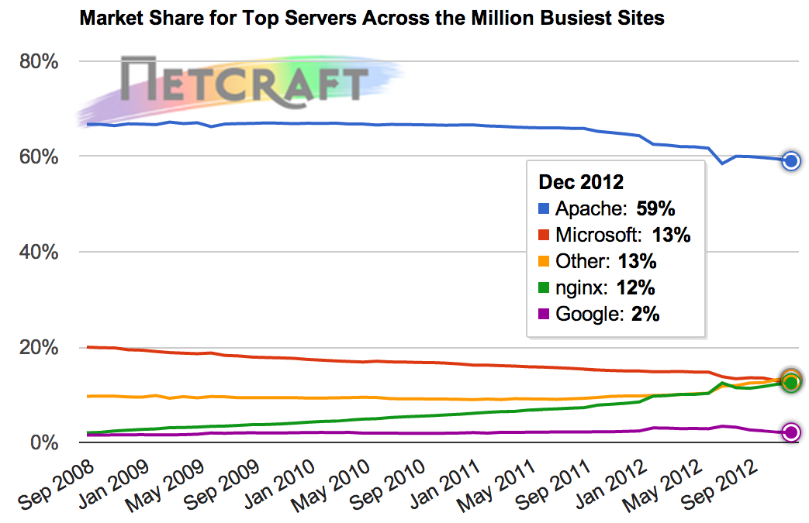
Q: Why?
A: Scale

Slide 20
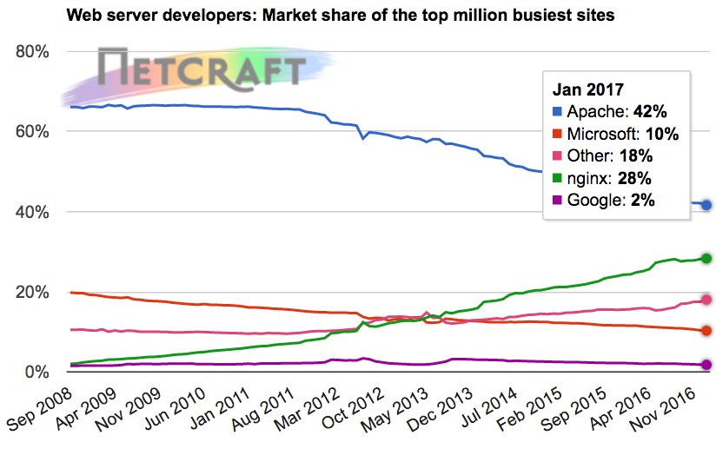
Scalable solutions

Slide 21
User-mode threads
Co-operative multitasking
  Instead fo a blocking read() from network, do a context switch to another user-mode thread
  No kernel context switch
Examples
  Coroutines in Lua
  Goroutines in Go
  Java green threads
  Windows ‘fibers’

Slide 22
Asynchronous programing
API
  Epoll, kqueue, completion-ports
Examples
  Libuv, libev, libevent
  Nginx
  NodeJS
    Bare-metal programming with JavaScript

Slide 23
Case study: Erlang programming language
Everything is a user-mode “process”
No memory sharing…
…message passing between processes instead

Slide 24
Case study: go
Massive use of ‘goroutines’
Message passing via ‘channels’ between goroutines

Slide 25
Contrast: dealing with memory
Old school
  Many processes
  All doing moderate memory
New school
  One process
  Allocating most all the memory in a system

Slide 26
Different heap
Get a “lock-free” heap supporting memory allocation across many threads
  Hoard, SuperAlloc, etc.
Many straight ‘malloc()’ replacements you can benchmark for which is best for your software

Slide 27
Garbage collection is bad
GC is usually “stop-the-world’
  This hurts network apps
  Introduces large amount of jitter
Continuous GC is slow
Conclusion
  GC languages like Go suboptimal
  Non-GC Rust better
  C is always best, of course

Slide 28
main memory– 300 cycles
L3 cache – 30 cycles
L2 cache – 12 cycles
CPU
L1 cache – 4 cycles
Notes:
RAM is a lie. RAM stands for “random access memory”, but it’s not. You can ignore this lie in normal code because caching hides it from you, but you have to pay attention when writing scalable code.
The problem with memory is that it’s really far away from the CPU. The L1 cache can be accessed in 4 clock cycles. Moreover, since CPUs are pipelined, that 4 cycles can usually be masked from the programmer so that it’s essentially 0 cycles away. The l2 and L3 cache are further away. That’s why you care that atomic operations are an L3 operation – they take 30 cycles.
But main memory is really far away. When the CPU needs to wait on main memory, it can take 300 clock cycles. Note that these aren’t shown at the correct scale, as it’d make things too small.

Slide 29

.

Slide 30
co-locate data
Don’t: data structures all over memory connected via pointers
  Each time you follow a pointer it’ll be a cache miss
  [Hash pointer] -> [TCB] -> [Socket] -> [App]
Do: all the data together in one chunk of memory
  [TCB | Socket | App]
Notes:
Here’s the problem with Linux. It hashes the IP and port numbers and looks up the result in a hash table. That hash table is just a list of pointers. It follows that pointer to the TCP control block entry. That block then points to a separate socket data structure. An application then has it’s own table of application layer data associated with the socket.
Following each of these pointers is a cache miss. You are looking at a minimum of 4 cache misses per packet.
This could be combined together. Instead of separate TCB, socket, and app structures, combine them altogether in one structure. Instead of a hash table of pointers, create a hash table of the structures themselves. In other words, allocate half the system’s RAM to your TCP entry table. This reduces many cache misses to a single one.

Slide 31
compress data
Bit-fields instead of large integers
Indexes (one, two byte) instead of pointers (8-bytes)
Get rid of padding in data structures
Notes:
You can make your structures smaller. If a number has 10 values, you don’t need 32-bits to store it, but only 4 bits, so use a 4-bit bitfield.
The performance cost is far less than you imagine, and the scalability benefits greater.
Also, this isn’t a portability problem: most of you learned bitfields from Stevens trying to overlay on packets. That doesn’t apply for internal structures.
Pointers are 64 bits. Instead of pointers, you can use indexes and offsets that are fewer bits.
Today’s systems have a lot of padding in data structures that you can get rid of.

Slide 32
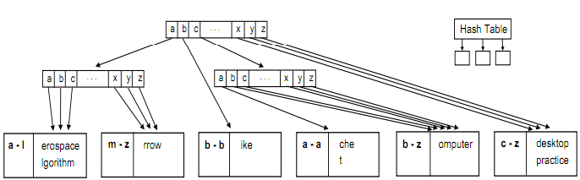
“cache efficient” data structures
Notes:
Consider a binary tree. For a tree with a million entries, it takes 20 tests. Now consider how all 20 tests will be cache misses.
The alternative is cache efficient binary trees. A cache line is 64 bytes, which holds 16 32-bit integers. Instead of doing a binary test at each node in our tree, let’s do a linear search of 16 integers. This reduces the 20 cache misses down to 5 cache misses for a million node table.
Consider how a firewall needs to do a lookup of potentially a million firewall rules using prefix matching. Using a cache efficient data structure will be much faster even though technically it should be slower.

Slide 33
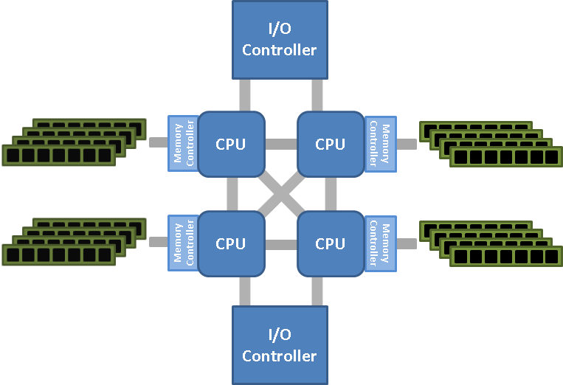
“NUMA”
Doubles the main memory access time
Notes:
Pin thread to CPU, then pin physical memory to the thread, so that all allocations come from the thread

Slide 34
“huge pages”
Avoid unnecessary TLB cache misses
At scale page tables won’t be in cache
  Thus, uncached memory lookups require two memory lookups
  It’s a big reason why kernel code (no virtual memory) is faster than user-mode
    That, and no transitions
Linux auto-hugepage
  Linux now automatically gives huge pages underneath

Slide 35
Contrast
Old school
  Many users on the same system
New school
  Appliance dedicated to a single task
  Any security you’ll have to do yourself
  E.g. CloudFlare revealing uninitialized memory

Slide 36
Contrast: network
Old school
  A network stack for many processes
New school
  Your own network stack, not shared with others

Slide 37
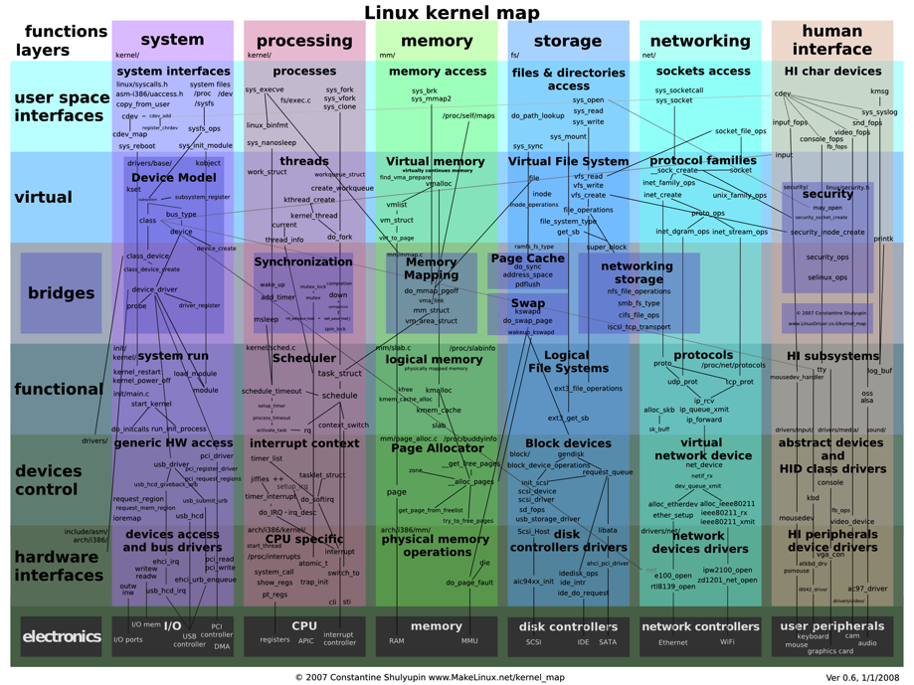
Notes:
This picture shows the complexity of the Linux kernel. When a packet arrives, it goes through a torturous route through the Linux networking stack. When you are using the Apache model with processes, the path the packet takes becomes even more complex.
There’s an alternative to this. Instead of using Linux, you can write your own packet driver for a hardware card. This card ships the packets directly to your application with zero overhead.

Slide 38
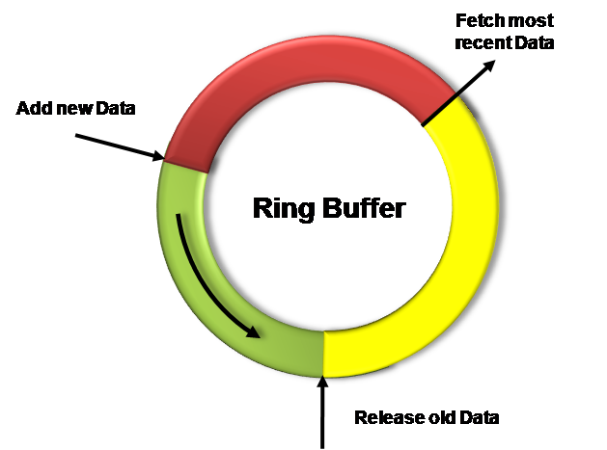
Map driver buffer with userland
All drivers have ring-buffers
  But Linux pulls packet out, with indeterminate lifetime
  Lifetime of these packets is whenever the tail moves forward
Near zero overhead
  About 10 CPU instructions per packet to free up a packet buffer
Notes:
The alternative to the Linux stack is to unhook the driver from the Linux kernel, and create a ring buffer mapped in user-space.
This is nearly zero overhead performance.
The thing is that it’s not general purpose. It can only work for a single application on the system. But for internet devices, that’s exactly what you want.

Slide 39
DMA isn’t
CPU
L3 cache

Slide 40
Where can I get some?
PF_RING
  Linux
  open-source
Netmap
  FreeBSD
  open-source
Intel DPDK
  Linux
  License fees
  Third party support
    6WindGate
Notes:
A lot of companies have written their own proprietary drivers to do this. That’s what we did for BlackICE 15 years ago.
These days, there are two primary sources to look at. The best known open-source solution is PF_RING, though I think there are alternatives if you look hard enough. The best known commercially licensed alternative is the “Intel DPDK”, though there are others as well.
There are also companies like Napatech that try to sell you special network cards with hardware acceleration. As far as I can tell, they are mostly snakeoil.

Slide 41
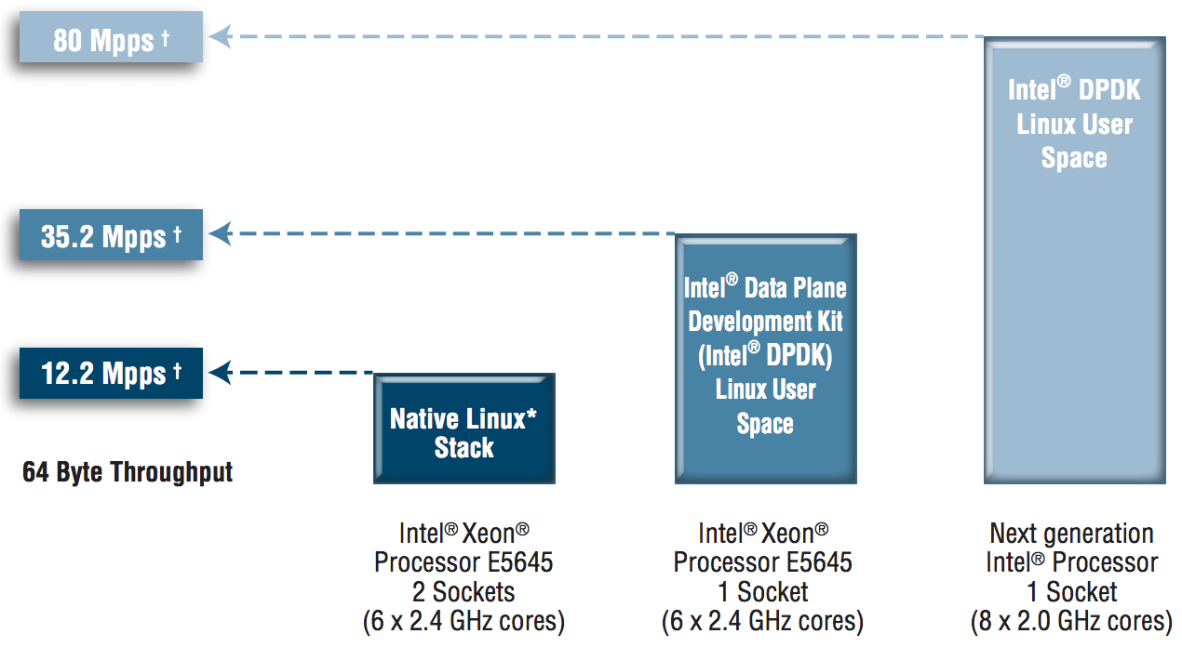
200 CPU clocks per packet
http://www.intel.com/content/dam/www/public/us/en/documents/solution-briefs/communications-packet-processing-brief.pdf
Notes:
Here are the benchmarks according to Intel. Using their DPDK, they achieve an 80 million packet per second forwarding rate. That’s roughly 200 clock cycles per packet.
What’s strange about this benchmark is that it understates their advantage. That’s packet delivered all the way to userspace and back again, in 200 clock cycles. The equivalent Linux test keeps all the packet sin the kernel. Trying to get those packets to user space, such as with libpcap, drops that rate to less than a million packets/second. I can’t figure out how to get Linux to go faster than 1-million packets/second.
When budgeting for a C10M application, you can assume 200 clock cycles to receive and retransmit a packet. At a rate of only 10 million packets/second, that leaves a budget of 1800 clock cycles per packet.

Slide 42
Old UDP: 500 kpps
Thread
Thread
Thread
Thread
Thread
UDP
IP
Adapter
Notes:
Consider the old UDP stack where software (like a DNS server) has threads calling recv() on a socket, trying to receive packets as fast as possible. On a modern quad-core, this is about 500,000 packets/second.
Remember how I said “sharing memory is death” for mutli-core scaling ,well, many threads trying to read from the same UDP packet queue are doing that.

Slide 43
UDP + receive queues + SO_REUSEPORT = 3 mpps
Thread
Thread
Thread
Thread
Thread
UDP
UDP
UDP
UDP
UDP
IP
IP
IP
IP
IP
Adapter
Adapter
Adapter
Adapter
Adapter
Notes:
Linux has upgraded this.
With receive queues, you can split the adapter into multiple virtual adapters that balance the load.
Llikewise, with SO_REUSEPORT, you can create multiple UDP queues for incoming packet.
This balances the load across multiple CPUs more efficiently.

Slide 44
Custom = 30 mpps
Thread
Thread
Thread
Thread
Thread
Adapter
Adapter
Adapter
Adapter
Adapter
Notes:
With a custom stack, it’s embarassingly parallel. There are no interactions between the threads. Other than some practical resources constraints, like the L3 cache or memory bandwidth, this will scale pretty well.
…at least up to 16 virtual adapters, the most Intel supports right now.
Actually, it’s probably faster than this – but in my code, I only go to 30 million packets/second on a dual-10gbps adapter.

Slide 45
User-mode network stacks
PF_RING/DPDK get you raw packets without a stack
  Great for apps like IDS or root DNS servers
  Sucks for web servers
For TCP, there are commercial stacks available
  6windgate is the best known commercial stack, working well with DPDK
  Also, some research stacks
  Requires change in your software to exploit them, such as asynchronous

Slide 46
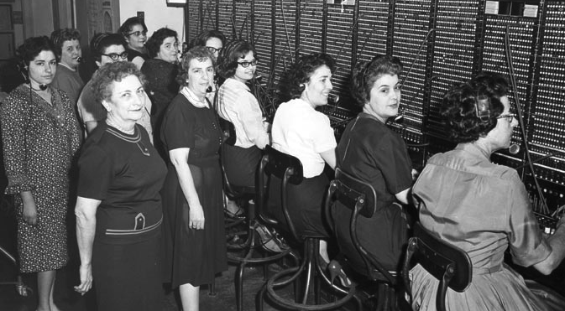
Control plane vs. Data plane
Notes:
Notice the keyword Intel uses: the “data plane” development kit. This is a key word you need to learn.
Let’s talk history for the moment. Way back in the day, the telephone system worked with operators. These people would connect plugs on a huge switch board, essentially creating a single electronic circuit between you and whomever you were dialing.
Then the digital revolution came along. It was still circuit switching, but the circuits were streams of bits in the T1 system. These circuits were hardware made of custom ships. But the circuits themselves were setup using software. Unix was created by AT&T back in the data to be control system for this hardware.
Then came the Internet revolution and packet switching. Unix, that system designed for control, suddenly became overloaded to also forward data. Many of the first routers were simply Unix boxes.
The problem is that while Unix is great as a control system, it still sucks at handle bulk data. We use Unix for web servers, but it just isn’t built to scale. The reason is tradeoffs. You can do data or control, but not both.
Today, keywords to describe this problem is “control plane” processing and “data plane” processing. That’s what you plug into the google for more info.

Slide 47
Data Plane
RAM
CPU
NIC
Control Plane
Notes:
You can reserve the resources.
On most Oss, you can slice up memory as you want, such as hugepage allocations.
On Linux, you can essentially disconnect CPUs from the OS so that no interrupts happen, no threads will be scheduled on those CPUs. Only those threads manually scheduled, by you calling an API, will run on those CPUs.
On Linux, you can replace the driver for specific NICs, reserving them for your own purposes, not used by the OS.
At this point, Linux is running as a control plane on a couple CPUs while your special software completely controls the remaining resources for data-plane.

Slide 48
Case study: masscan
What is…
  Ports scans entire Internet
  Like nmap, but more scalable
Transmits 30-million packets/second
  PF_RING user-mode ring-buffer
Pointer to TCB, then TCB
  Receives far fewer packets-per-second than an IDS
Has it’s own IP address
  Even when shared with machine

Slide 49
Case study: robdns
What is..
  DNS server, authoritative only (non-recursive)
  ~10-million queries/second
    Built to withstand DDoS
    BIND9 does 100,000 queries/second
Biggest gains come from custom networking
  User-mode ring-buffer
  Without that, the limit is 1-million queries/second
Other optimizations then become reasonable
BIND9: if you can’t write fast, you should instead write safe
  Should be written in JavaScript, not C

Slide 50
Case study: BlackICE
What is..
  Intrusion prevent system
  (aka. Inline IDS)
Dual 3GHz Pentium 4
Forwards 2-million packets/second (“line speed”)
10-microsecond latency
Hash directly to TCBs
  Avoids one pointer chase
  Allows prefetching of next TCB
On Windows and Linux

Slide 51
Conclusion

